Slide 1
SERMERSOOQ WEST REGION TOURISM REPORT Q 3 – Q 4 2015 VISIT GREENLAND

Slide 2
INTRO
This is the first region specific quarterly report on tourism statistics from Visit Greenland. The first quarterly report (Q2-15 can be found on tourismstat.gl/analyser) only dealt with tourism in a national perspective, as no complete sets of data on the important high season (Q3: July, August, September) were available at the time. Henceforth VG will be publishing quarterly summaries of tourism data including findings and analysis on the high season.
Method
We are primarily using data from Statistics Greenland (stat.gl), but we will be referencing tourism data from Iceland as well as other relevant countries and regions either through national statistics bureaus or international organizations such as unwto.org. All diagrams and data sets are available to all, and this report can be downloaded as a power point presentation with diagrams and text for free use. Feel free to email market research consultant Mads Lumholt (lumholt@greenland.com) to request specific data, estimates or diagrams should the need arise.
It should be noted that in regards to flight passenger statistics Statistics Greenland (stat.gl), VG and the Department of Business (Erhvervsdepartementet) have joined forces and began the registration of country of residence July 1st 2014, which is the reason why this report only shows growth calculations on the basis of a comparison between Q3-14 and Q3-15, as it is the first period to be compared historically. In time the data history will allow us to apply more long-term and in depth perspectives.
Registration of country of residence
VG cooperates with Grønlands Statistik in order to standardize the registration of country of residence concerning data on flights, cruises and overnight accommodation. Up until now the selection of countries that we have been able to register has not coincided, but in regards to 2016 it appears that we will be able to extract data on the three areas in the following 26 countries:
The Nordic Region: Greenland, Iceland, Denmark (incl. Faroe Islands), Sweden, Norway. Europe: England, Germany, France, Switzerland, Austria, Holland, Spain, Italy, Russia, Poland and ’Other European countries’. Asia: China, Japan, South Korea, Taiwan, Hong Kong, Malaysia, Indonesia, Singapore and ’Other Asian countries’. In addition: USA, Canada, Australia and ’Others’.
Cooperation with Air Greenland
It is a great advantage to VG that has a cooperation agreement with Air Greenland on a number of areas, including market research. This spring we have collectively ordered two thorough market surveys on Great Britain and the USA (with 4,000 respondents) through nit-kiel.de. VG has also requested that NATA finances a similar survey on Germany in Q1-16, and this has been granted. We look forward to seeing the results of the large surveys and to share the valuable knowledge with the industry.

Slide 3
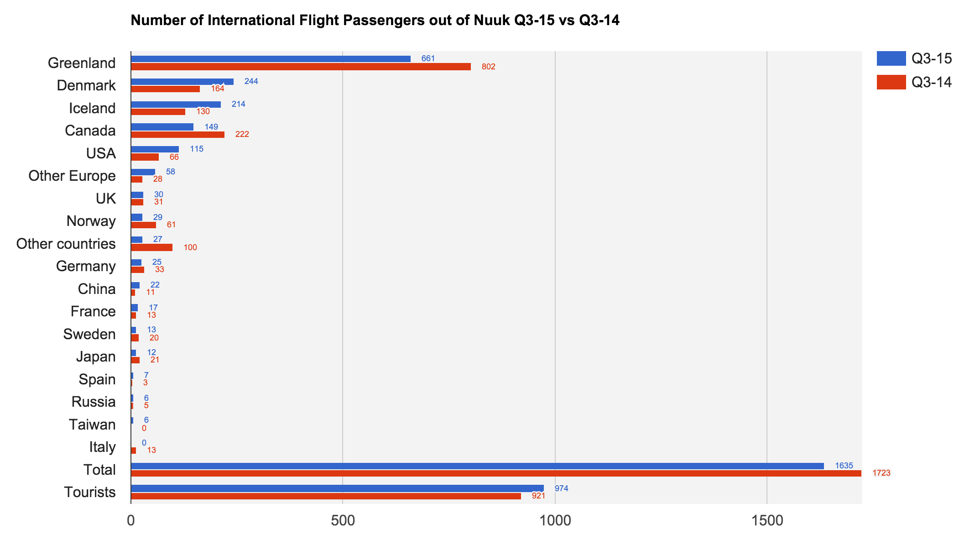
FLIGHT PASSENGERS
A 5.8 % growth in the number of tourists leaving via Nuuk Airport is positive. However, the number of tourists to/from Nuuk through the direct Iceland route is still fairly modest according to the number of tourists passing through Kangerlussuaq. We do not have the exact data at the present time, but typically there will be 4-5 Dash-8 flights (37 pax) daily in Q3 and 4-5 flights during weekdays for the rest of the year, approximately 50,000 pax per annum. Therefore we cannot use the data below to deduce how the entire flight based tourist-inflow to Nuuk and Sermersooq West is doing as a whole. It is still a good indicator that suggests that traffic directly via Iceland is influenced positively by the general increase in tourism in Iceland these years.
The flight pax diagram shows a large decrease for Greenland and Canada. It is primarily due to the termination of the Nuuk-Iqaluit route at the end of the 2014 season. The large decrease in Other may be attributed to the decrease in investigative activities.
The three largest markets for Nuuk via Iceland are still Denmark, Iceland and Canada, but USA is catching up with Canada.
Since 01/01/16 VG and mit.gl have cooperated to increase the number of country of residence to be registrered and have added the following countries: Switzerland, Austria, Holland, Poland, Hong Kong, Singapore, Malaysia, Indonesia, South Korea and Australia.
Growth for Sermersooq West (incl. residents of GL): -5.1%
Growth for Sermersooq West (tourists): 5.8%
Growth all regions combined (incl. residents of GL): 9.8%
Growth all regions combined (tourists): 24.9%
Thereof charter passengers:
Q3-15: 170 pax
Q3-14: 246 pax
Kilde: stat.gl
Source: stat.gl

Slide 4
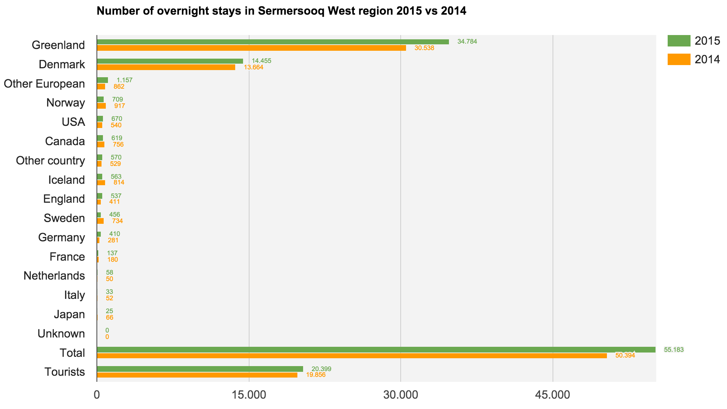
OVERNIGHT STAYS
As we have complete data on all quarters from 2014 and 2015 we can compare the periods (flight statistics are only available from Q3-14 and onward). The 2,7% increase in overnight stays correlates with the flight pax numbers on the Nuuk-Reykjavik route, and serves as a positive indicator for the tourism as a whole Sermersooq West. As the Nuuk-Iqaluit route terminated at the end of the 2014 season, worse results could have been expected. It does however show that the incoming traffic from Kangerlussuaq is a crucial factor for Sermersooq W and Nuuk.
The growth in international tourism is 3.7% in Europe (the continent with the lowest growth) and 6.7% for Asia-Pacific which leads the global growth (source: Statista.com), so if the increase in overnight stays is the clearest indicator for the development in Sermersooq W, the region is above the European average which is a positive indicator.
The last couple of years we have witnessed a massive growth in private accommodation via airbnb.com, and it has reached Nuuk as well. Though not during summer high season, Nuuk often experiences capacity limitations, so it is good news for the tourism that the Airbnb concept is expanding its capacity. In general it is healthy with increased competition in accommodation.
Growth for Sermersooq W (incl. Residents of GL): 9,5%
Growth for Sermersooq W (tourists): 2,7%
Combined growth for all regions (incl. Residents of GL): 4,3%
Combined growth for all regions (tourists): 1,3%
Source: stat.gl

Slide 5
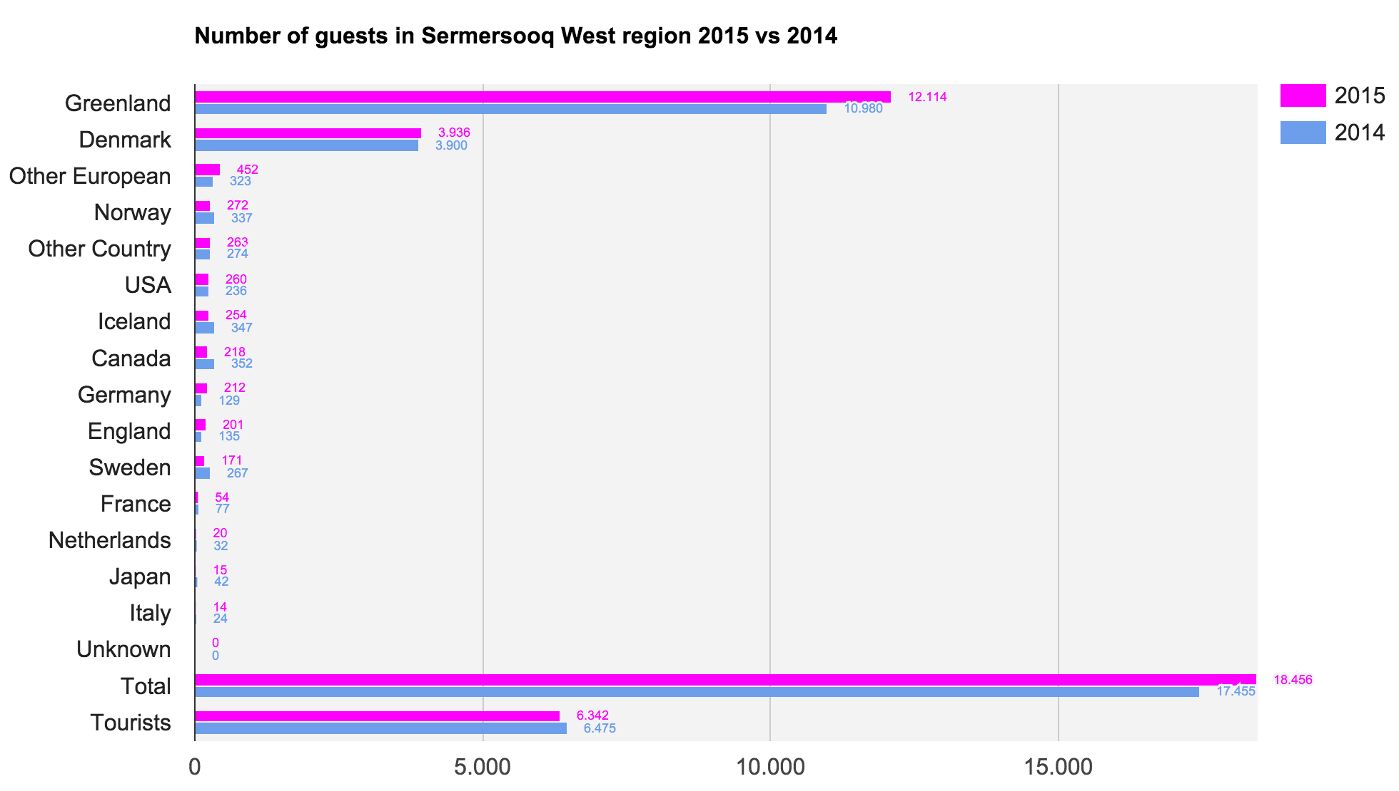
OVERNIGHT STAYS
The data on Sermersooq West represents a mixed picture. Looking at the number of guests (tourists) in the accommodation of the region, the negative growth of -2,1%, compared to 2,7% more tourist overnight stays suggests that each tourist on average has bought considerately more overnight stays than in the same period of 2014. This pattern points in the opposite direction than the general tendency in the rest of Greenland. This could be because it is generally a different type of tourist that comes to the region and stays longer.
It may be connected with the fact that the route between Nuuk and Iqaluit terminated at the end of 2014. It is possible that guests via the Iqaluit route in general stayed for a shorter period in Nuuk in 2014 than the average tourist visiting the city in 2015. If this be the case the negative growth of -2,1% is not as negative an indicator as could otherwise have been feared.
The most important indicator is still ’number of overnight stays sold’ as it is a clearer indication of the revenue than number of guests.
Growth for Sermersooq W (incl. residents of GL): 5,7%
Growth for Sermersooq W (tourists): -2,1%
Combined growth for all regions (incl. residents of GL): 9.2%
Combined growth for all regions (tourists): 4.6%
Kilde: stat.gl

Slide 6
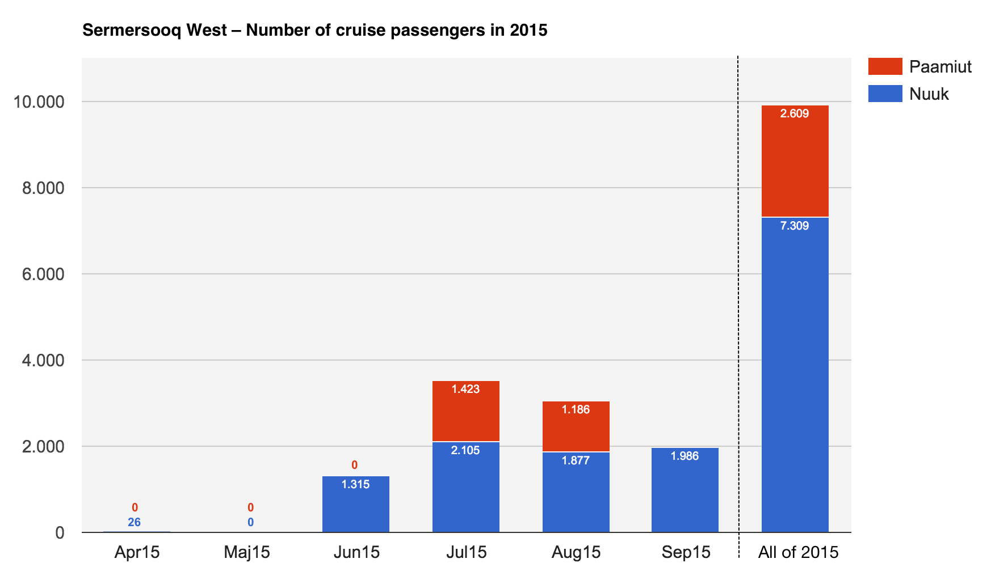
CRUISES
As the cruise tax has been changed from January
2015 from being a fee per cruise guest to being a tax per
port call and gross tonnage, we cannot compare 2015
with 2014 as the old ’pax tax’ has not been linked to a
specific port or region. In general we have seen a growth
in cruises of 10.8% from 2014 to 2015.
The new tax shows the number of arrivals per port,
number of passengers as well as the nationality (up to 20
different) of the guests.
So far the numbers on nationality for all regions in
Greenland combined are available.
These are the top 10 countries:
Germany, USA, UK, Canada, France, Denmark,
Switzerland, Australia, Austria and China.
Source: stat.gl
In 2015 GP Wild did a survey for VG in Qaqortoq, Ilulissat and Ittoqqortoormiit with 1,649 cruise passengers and 279 crewmembers participating:
89% of the respondents felt very satisfied with their visit in Greenland
61% even felt that the visit exceeded their expectations
The friendliness of staff, the friendliness of locals and guided tour were the things that got the highest scores (between 4.3 and 4.1 out of 5)
98% of the cruise guests went ashore and for 92% of the guests it was their first visit to Greenland
76% of the guests were at least 65 years old and the average guest had a household income of 600,000 DKK.
Top 4 nationalities: USA 48%, UK 21%, Germany 12% and Australia 6%

Slide 7
SUMMARY
Sermersooq West in a Greenlandic Perspective
There were less international passengers travelling directly out of Nuuk in Q3-15 than the year before, but this could be due to the relatively significant decline in the number of passenger residing in Greenland, and is mainly to be attributed to the terminated Nuuk-Iqaluit route. If one only looks at the category tourists one will find an increase of 5.8%. As previously mentioned we do not have data on the large number of flight pax entering the region via Kangerlussuaq, but looking at the number of overnight stays we see positive indicators. Qaasuitsup and Qeqqata exhibit solid tourism growth regarding both flights and overnight stays. Kujalleq has had an increase in tourists by flight (6.1%) but a decrease in the number of tourist overnight stays (-27,8%). Sermersooq East has experienced a decline in the number of tourists by flight (-1%) as well as a decline in the number of tourist overnight stays (-17.9%).
Colorful Nuuk
Along with other stakeholders and VG, the Sermersooq Business Council have created a coherent brand for the most important destination in Sermersooq W. The new Nuuk brand stages the city as a modern (albeit very small) capital in unique cultural and natural surroundings. On the one hand it may attract those looking or a ‘city break’, and on the other hand it must still attracts the adventure segments, the globetrotters, nature lovers/appreciators and culture lovers/appreciators, because ’colorful Nuuk’ has something to offer all of the aforementioned segments. When marketing Nuuk it is worth considering which segment one wishes to engage, as the choice of pictures, words and products must be selected carefully in order to be coherent. VG has developed guides on how to best communicate with each segment. They can be downloaded: goo.gl/32g4yH
Market Tendencies
One of the biggest markets analyses on new trends can be read here: goo.gl/BSiHJy, and among other things it highlights the following tendencies relevant for Sermersooq W:
#1 Seeks new experiences #3 Chooses destinations based on culture and special offerings #6 Handles online reputation. It tells the story of how tourists gradually are becoming more adventure oriented (ie trips that offer culture, nature and new experiences) and how they more and more often tend to seek out destinations that are not mainstream. Furthermore it is becoming more and more important how products and accommodation are being rated on reviewsites such as TripAdvisor. Creating a profile on TripAdvisor offer increased visibility as well as searchability.
In the last months of 2015 Great Britain and USA have shown outbound growth rates of 9% and10% respectively (source: LA Times and ons.gov.uk). It can be highly recommended to increase the targeting of these markets, as they also happen to be the two largest segments through Keflavik, showing impressive growth.

Slide 8
Produced by Mads Lumholt
Visit Greenland

