Slide 1
TOURISM REPORT Q 3 – Q 4 2015 VISIT GREENLAND

Slide 2
TOURISM STATISTICS REPORT Q3 2015 – VISIT GREENLAND
The quarterly report contains an introductory summary as well as the following elements:
Key figures on tourism in Greenland 2015 (source: tourismstat.gl and stat.gl)
Flight passenger statistics
Cruise statistics
Overnight stay statistics
Additional data
User data on greenland.com (source: Google Analytics)
The latest quarter key figures on Iceland (source: statice.is)
The latest international trends and tendencies (source: see last page)

Slide 3
INTRO
This is the second quarterly report on tourism related statistics released by VG. It will continue to be published quarterly displaying findings from the previous quarter.
Finally a Positive Development – and New Data Available
Q3-4 2015 saw an increase of 23.8% more tourists (excl. residents of GL) arriving in Greenland by airplane compared to Q3-2014 after approximately five years with a general decline. Q3 2015 is the first quarter we can compare flight passenger statistics with the same period the year before, as the the flight pax registration did not start until July 2014. The mix of flight passengers according to country of residence are some of the most important data in order for us to say something qualified about the demand in different markets, and as we now have data on the development from period to period it is even more valuable.
New Flight Routes and Increased Air Services
Air Greenland has announced increased international air services in the form of a new summer flight route between Keflavik and Ilulissat as well as increased summer air services of Narsarsuaq. Furthermore Air Iceland has announced the opening of the summer flight route Keflavik-Kangerlussuaq flying with the flight type Bombardier Q400 that carries up to 76 passengers.
Greenland in Top 10 and Top 20
Greenland has been fairly overlooked as a destination in the past, but this autumn Greenland made the Lonely Planet Top 10 ’Best in Travel 2016’ and the National Geographic Traveler’s Top 20 ’Best trips 2016’. These are two of the most influential travel media in the world, and the placings can help boost Greenland in terms of demand in 2016. The listings have led to placings on other top 10/20 lists.
Growth in the Global Tourism
Even during the financial crisis the global tourism has had a growth of a couple of percent. In later years this growth has increased especially in the ‘growth economies’ in South East Asia also in spite of the slowing of the growth of China. In the latest quarters Western countries such as USA and the UK have had growth rates of up to 9-10% (sources: national statistical offices and UNWTO), in the nearest international hub of Greenland, Keflavik, the high growth of USA and the UK can be detected (source: statice.is).

Slide 4
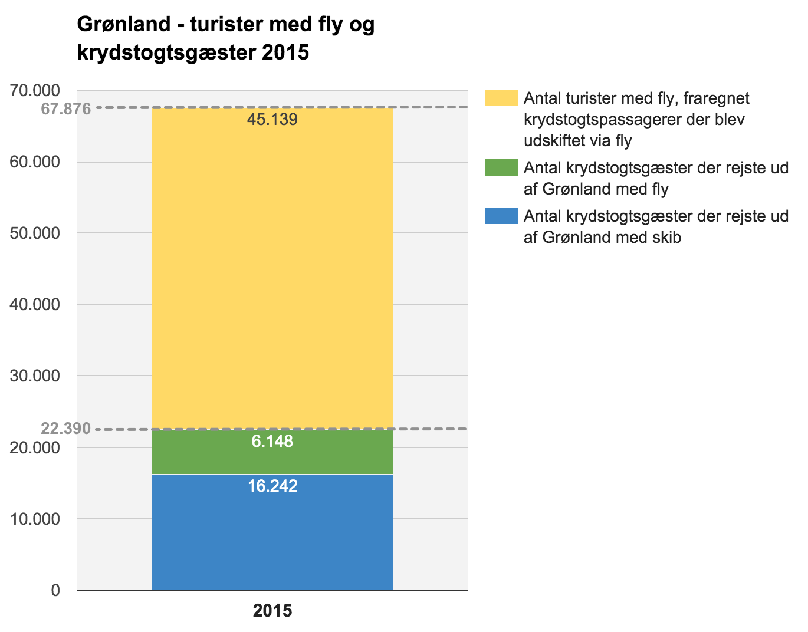
NUMBER OF TOURISTS IN GREENLAND 2015
Greenland – tourists by plane and
cruise guests 2015
In 2015 it is, for the first time, possible to calculate excactly how many tourists that visited Greenland within one calendar year.
The grapf to the left is to be understood as follows:
In 2015 there were 22.390 cruise tourists, of which 6.148 cruise passengers are included in the flight passenger registrations, as they were flown out of Greenland at the end of their cruise
51.287 tourists have been registered on planes out of Greenland. When subtrackting the 6.148 cruise tourists that were flown out of Greenland via Kangerlussuaq, we end up with 45.486 land-based tourists
Overall Greenland was visited by 67.876 tourists in 2015
Number of tourists by plane, apart from cruise guests exchanged via plane
Number of cruise guests that travelled out of Greenland by plane
Number of cruise guests that travelled out of Greenland by ship
Source: stat.gl

Slide 5
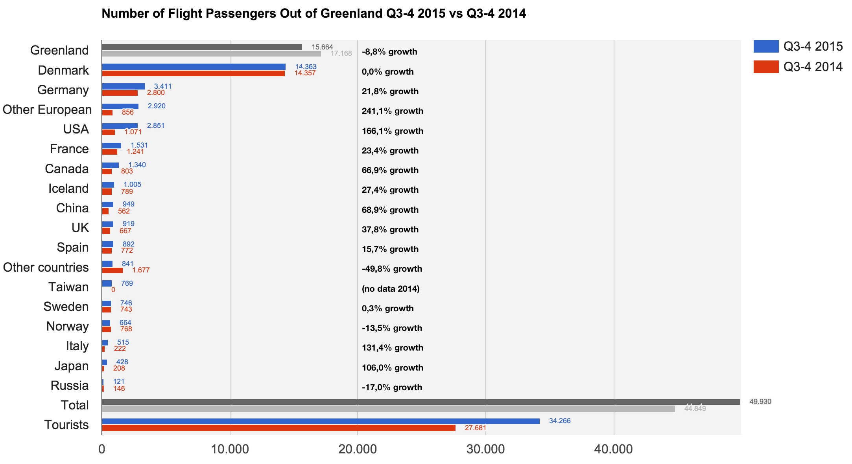
FLIGHT PASSENGER STATISTICS
Q3-4 2015 was characterized by strong growth in the category of international tourists of 49.4% (excl. residents of GL and DK). Q3-4 2015 at the same time saw 8.8% fewer GL residents compared to the same period in 2014. The number of DK residents is status quo. Every second flight passenger in Q3-4 2015 is a resident of a different country than GL and DK. In 2014 the same could only be said for every third passenger. In 2008 the total number of flight passengers peaked at 76,068 pax, and decreased to 69,580 pax in 2014. With an increase of 11.3% (Q3-4 2015) in the total number of flight passengers, 2015 is the best year so far with 80,862 pax. Please note that flight passenger country of residence has only been registered since July 2014.
We are experiencing a strong growth in Other European, Germany, USA, France, Canada, Iceland and China. After Denmark they represent the largest markets.
To gain more insight into the category Other European (country) along with Mittarfeqarfiit we have added Austria, Switzerland, Holland and Poland from 2016. Furthermore the following Asian countries have been added: Hong Kong, Singapore, Malaysia, Indonesia, South Korea and Australia.
Thus the maximum 26 countries are registered according to the contract with Mittarfeqarfiit, as the registration must be completed with just one click on an iPad in airport security.
11.3% increase in the total number of flight passengers
in Q3-4 2015 vs Q3-4 2014
23.8% increase in the number of tourists
(excl. residents of GL) in Q3-4 2015 vs Q3-4 2014
49.4% increase in the number of international tourists
(excl. residents of GL and DK) in Q3-4 2015 vs Q3-4 2014
Source: stat.gl

Slide 6
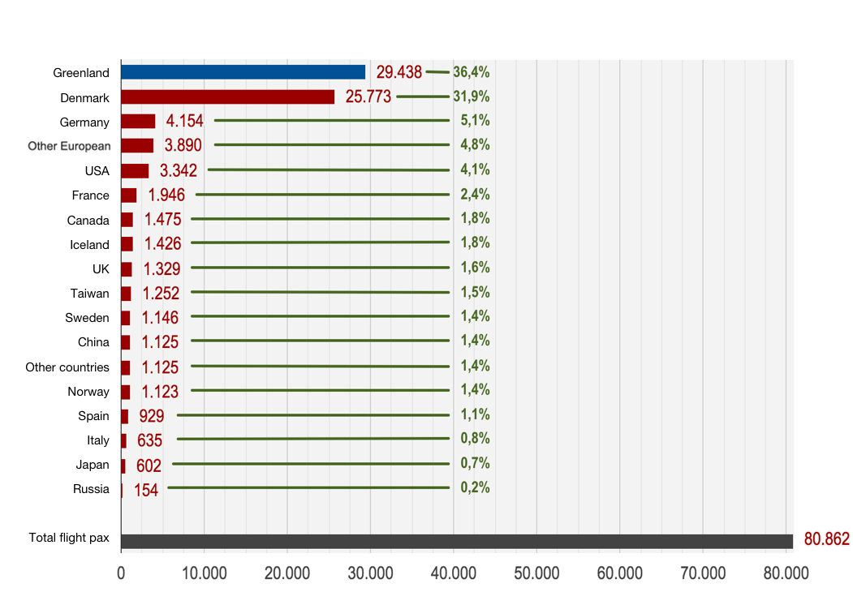
FLIGHT PASSENGER STATISTICS
On the basis of the Country of Residence registration of flight passengers, we can now see the overall distribution for 2015. We cannot yet, though, compare with the calendar year 2014, as the registration only started in Q3-14. 2008 was until recently the year with the most flight passengers (76.068 pax). During the years 2008 through 2014 (with 69.580 pax), there was a general tendency of decline in the number of annually passengers. 2015 now shows to have the highest number ever (80.862 pax) and an overall growth of 11,3% compared to 2014.
Number of flight passengers out of Greenland, by Country of Residence
The red colour in the graph to the left represents all of the tourist segments.
If the distribution among Countries of Residence reflected in the Q3-4 2015 report turns out to reflect a trend for the coming years, then we should expect the share of Greenlandic residents – maybe even also Danish residents to become smaller. The volume and share of other countries should increase accordingly.
Source: stat.gl

Slide 7
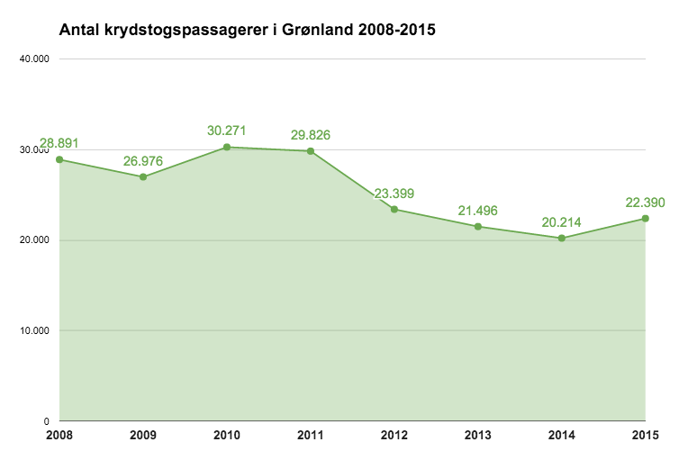
CRUISE STATISTICS
Compared to 2014, 2015 saw an increase in the number of cruise passengers of 10.8%. This came after a general negative growth since 2010 (a staggering -33% from 2010 to 2014). Stat.gl uses the period Oct.-Oct. called the tourist season.
Number of Cruise Passengers in Greenland 2008-2015
As per the 1st of January 2015 the pax tax (tax per passenger) was changed to a port call tax dependent on the number of port calls per gross tonnage. This will make it cheaper for especially the larger ships with fewer port calls than with the old pax tax. The financial gain is slightly smaller for the smaller ships.
As the planning horizon of the large cruise lines is often at least two years, it is unlikely that the growth we noted in 2015 is due to the change in the cruise tax. It must be caused by a larger demand for cruises in Greenland. One can hope that the reduced tax can lead to further growth in the long term.
2015 marks the first year that registered the country of residence among cruise guests. Top 10 countries are: Germany (46.5%), USA (13.4%), UK (7.4%), Canada (7.2%), France (4.4%), Denmark (3.5%), Switzerland (3.2%), Australia (2.7%), Austria (2.4%) and China (1.7%).
Source: stat.gl
Notes:
Number of Cruise Passengers in Greenland 2008-2015
10,000, 20,000, 30,000, 40,000

Slide 8
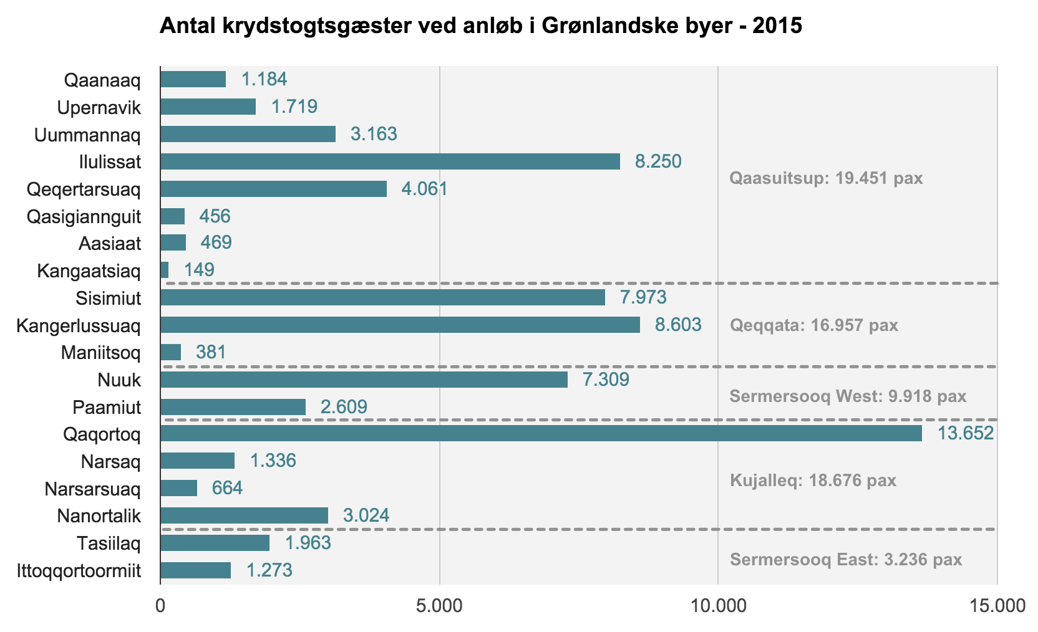
CRUISE STATISTICS
Number of cruise passengers arriving at Greenlandic ports 2015
As mentioned before, there were 22.390 cruise passengers visiting Greenland in 2015. When you take into account how many passengers visited each port, the collective number is, of course, much higher than the annual total, because every passenger usually visits several ports.
The graph to the left gives an overview of cruise tourism in Greenland, but only from the perspective of how many passengers visited each port – not from the perspective of how many ships or the size of the ships
Kilde: stat.gl
Source: stat.gl
Notes:
Der var som nævnt 22.390 krydstogtspassagerer i Grønland i 2015. Når man ser på hvor mange passagerer der besøgte hvilke anløbshavne, er det sammelagte tal selvfølgelig større, da en passagér kun tælles én gang, selvom vedkommende besøger flere anløbshavne i løbet af togtet
Diagrammet til venstre giver et overblik over krydstogtsturismen i Grønland, men kun ud fra ét perspektiv – nemlig hvor mange pax der besøgte hver anløbshavn
- ikke hvor mange skibe, hvor store skibene var osv.

Slide 9
CRUISE SURVEY 2015
In 2015 GP Wild did a survey for VG in Qaqortoq, Ilulissat and Ittoqqortoormiit with 1,649 cruise passengers and 279 crew members participating:
89% of the respondents felt very satisfied with their visit to Greenland
61% even felt that the visit exceeded their expectations
The friendliness of staff, the friendliness of locals and guided tour were the things that got the highest scores (between 4.3 and 4.1 out of 5)
98% of the cruise guests went ashore and for 92% of the guests it was their first visit to Greenland
76% of the guests were at least 65 years old and the average guest had a household income of 600,000 DKK
On average each guest spent ca. 370 DKK ashore (Note that cruise companies profit on tours), the equivalent of ca. 8.12 m. DKK in 2015
Half the crew went ashore and spent on average 30 DKK, the equivalent of 100.000 DKK in 2015, counting 15 crew per 100 guests on average
The most
important
secondary
nations in the
survey are
Australia,
Canada and
Switzerland.
48% of the respondents are from the USA
21% of the respondents are
from Great Britain
12% of the respondents
are from Germany
A similar survey was carried out in 2012. At the time 96.4% of the guests went ashore, and spent approximately 440 DKK each, which is the equivalent of 9.9 million Danish kroner in 2012.
In the last couple of years we have seen an increase in the number of cruises by the smaller cruise ship categories, with the 26-250 pax (also called expedition ships) showing the largest growth in the number of cruises (from 32 in 2011 to 76 in 2015). The 251-500 pax ships have also experienced more cruise departures (from 9 in 2011 to 19 in 2015).

Slide 10
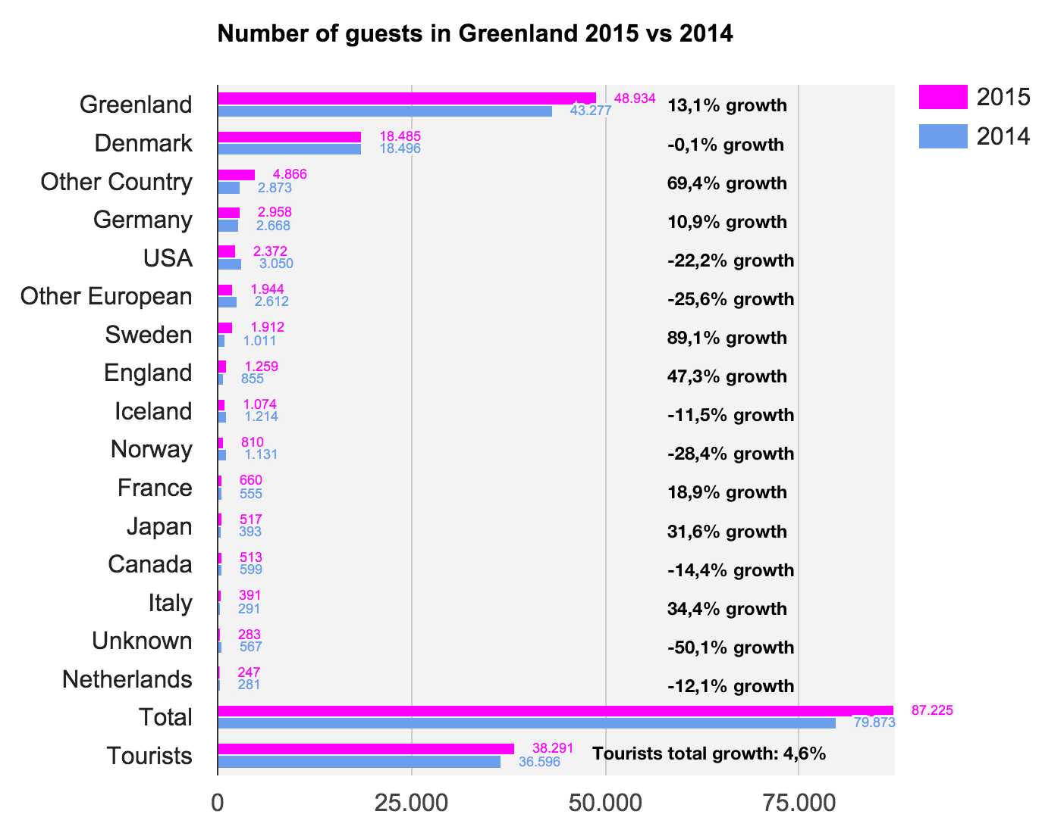
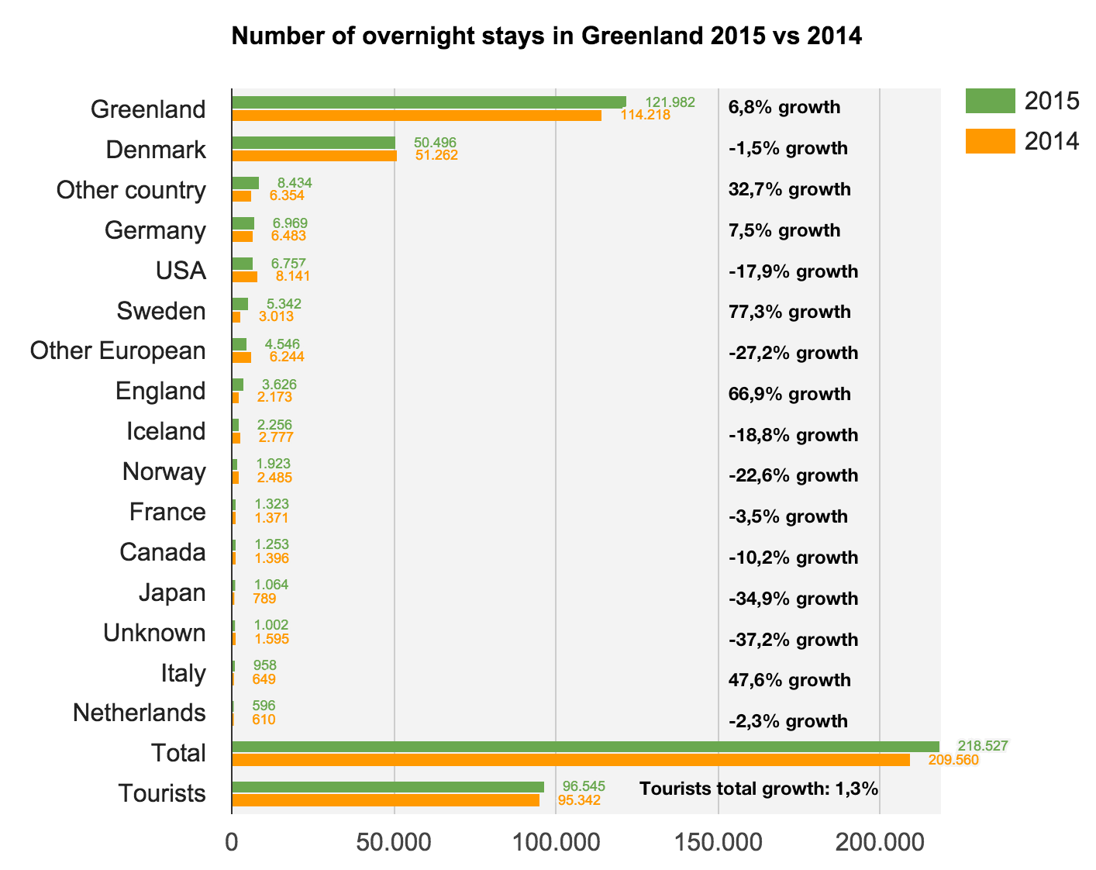
OVERNIGHT STAY STATISTICS 2015
Data from the accommodations in Greenland in 2015 versus 2014 show an increase of 1,3% in the number of tourist overnight stays, and a total growth of 4,3%.
Source: stat.gl
Source: stat.gl
For tourists one can observe a 4,6% increase in the number of guests, and the total growth is 9,2%. The two figures on overnight stays show that on average each tourist had fewer overnight stays than in 2014.
Please, keep in mind that only 47 (primarily hotels) out of at least 80 accommodations in Greenland submit records.
(Regional data can be found separately on tourismstat.gl under Analysis)
Notes:
Mangler de grå felter…

Slide 11
GREENLAND.COM STATS FOR 2015
Source: Google Analytics
For the first time ever Greenland.com has attracted more than 1 million users (1.09 M) in 2015. The largest audience comes from the following countries:
USA 26.5%, DK 12.6%, GER 10%, UK 8.6%, CAN 5%, IND 4.3%, AUS 4%, GRL 3.7%, CHE (Schweiz) 1.7% og FRA 1.4%.
30.356 is the number of times that users in 2015 have clicked through to greenland.com via an add or a website of tourist operator – which is known as a ’conversion’.
76% of the users are directed to us via searches on search engines such as Google, 14% by typing greenland.com in the browser address line, 6,3% via links on other websites and 2.1% via social media (primarily Facebook).
In general Internet users are becoming increasingly impatient when browsing and are more likely to leave a page if their interest is not immediately met. On greenland.com this results in the users opening slightly less pages per visit, and slightly more users tend to leave greenland.com without clicking to see more pages on the website – both compared to the year before.
VG is currently working on improving the user experience on the front page in order to get the users to click their way into the universe of greenland.com and ultimately purchase a trip.

Slide 12
WHAT’S HAPPENING IN ICELAND?
Flight passengers
As mentioned earlier both Air Greenland and Air Iceland will be opening new flight routes via Keflavik in the summer of 2016. Based on the data on Iceland we can objectively conclude a large potential in feeding in more tourists to Greenland with Keflavik as the hub, as Keflavik International Airport once again presents a growth of 25.5% in 2015 (source: isavia.is) compared to 2014. The Greenlandic increase in the number of passengers in Q3-4 2015 vs Q3-4 2014 was a total of 11.3%, and a massive 23.8% for tourists. The growth in global tourism is roughly 6%, so even if we are not quite on the same level as Iceland, it is still a high growth.
When it comes to flight traffic the most significant difference between Iceland and Greenland is the advantageous geographical placement of Iceland that makes it a natural Atlantic hub. Additionally new flight routes are opening (e.g. Wow Air, EasyJet and Icelandair) and air services are increased on the most popular routes, and Keflavik International Airport opened a new section this past summer. With respect to new flight routes and increased air services Greenland is on the slow side, but this is linked to the high season being so short while the shoulder season has not yet caught on.
Guests in accommodations
Iceland saw a 21% increase in the number of overnight stays in 2015. In November 32% of the guests came from Great Britain, 21% from USA and 6.5% from Germany. The share of Icelanders was only 12% (source: statice.is).
As mentioned the 2015 Greenlandic growth in the number of tourist overnight stays was only 1,3%, while the increase in relation to the number of guests (tourists) was 4,6%. In 2015 3.2% of the guests were from Germany, 3.1% came from the USA and 1.7% from Great Britain (the three biggest segments apart from Greenland and Denmark). Especially in relation to the share of British guests we are far behind Iceland.
One could see the big difference the numbers on overnight stays (between ISL and GL) as a bad indicator, on the other hand however the data tell us it is worth considering the opportunities the combination of Iceland and Greenland affords us. We have heard from several Icelandic operators that there is a demand for Greenland as an ’add-on’ when the right segments are targeted.

Slide 13
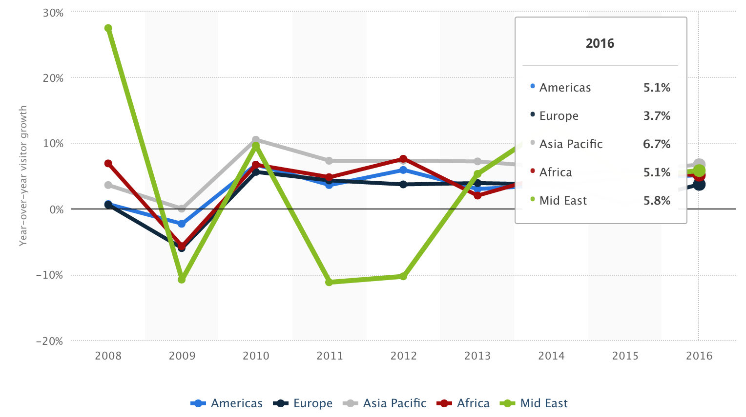
GLOBAL TRENDS IN 2016
The global tourism is surging with a few exceptions such as Russia that is inhibited by international sanctions. In spite of Europe being the part of the world with the lowest estimated growth (see the graph below) an increase of appoximately 4 % is still a solid growth.
According to ITB World Travel Trends Report 2015 ’city trips’ will primarily dominate growth, but ’adventure tourism’, which is relevant to Greenland is also predicted strong gorwth:
”Adventure tourism is on of the fastest growing categories in tourism.”
(UNWTO Report on Adventure Tourism, 2014)
Travelmarketreport.com describes the tendency:
”Travellers seek out autentic experiences, whether it be the local
off-the-beaten path destination or one that offers unique cultural
experiences.” (goo.gl/7QPrfa)
One of the biggest analysis on travel trends in 2016 is carried out by
Ipsos for TripAdvisor (TripBarometer Travel Trends 2016,
goo.gl/BSiHJy) and has over 34.000 respondents. It pinpoints 6 key trends
for 2016, and the following three are particuarly relevant
for Greenland:
#1 Seek new experiences #3 Choose destinations based on culture
(and special offerings) #6 Handles online reputation
(continued on the next page)
Source: Statista.com

Slide 14
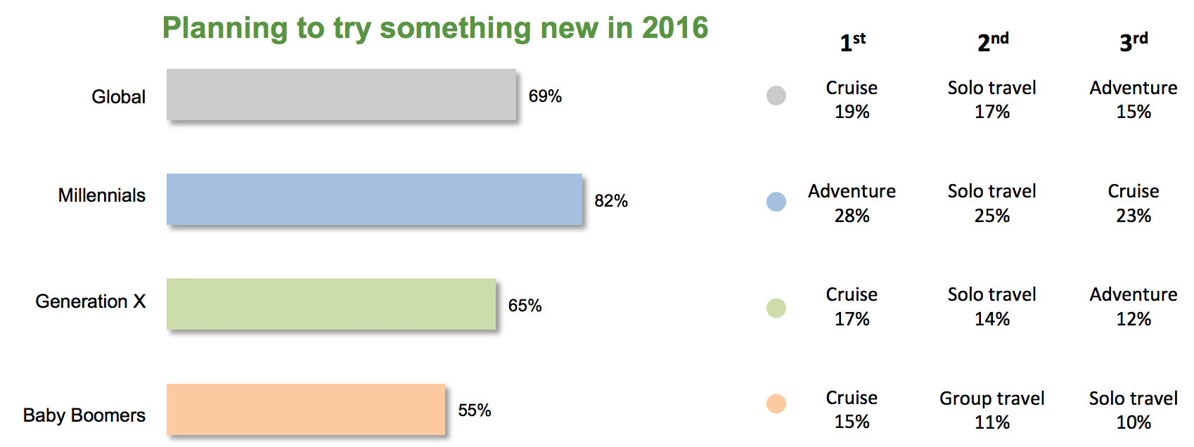
GLOBAL TRENDS FOR 2016 (continued)
Cf. #1 (Seek new experiences): The fact that very few people have ever been to Greenland is an advantage. As a tourist you are likely to be the first in your social circle to visit the country, and you are guaranteed to experience new and unique things.
Cf. #3 (Choose destination based on culture and special offerings): When marketing the destination Greenland it is important to highlight the unique Greenlandic culture. The ’Pioneering Nation’ brand is used to showcase the Greenlandic pioneering spirit and culture as well as the opportunity for the traveler to feel like a pioneer. A good example of a special offering is one that offers unique experiences at a good price in the shoulder season thus making the shoulder season a positive selling point as well as an incentive for previous high season guests to come back.
Cf. #6 (Handle online reputation): According to the analysis the rating on review sites (such as TripAdvisor) is the second most important factor for travelers aside from price, when they book accommodation. VG therefore recommend that all accommodations and tour operators create a profile on TripAdvisor, allowing the users to rate the experienced quality thus improving the visibility and credibility of the products.
One third of the respondents plan to increase their travel budget in 2016, and all segments are very eager to ’try something new’ in 2016.

Slide 15
This tourism report was developed by Mads Lumholt
Visit Greenland

