Slide 1
Tourism Statistics Report 2018
Capital Region

Slide 2
Introduction
This year the regional reports have been delayed, because it did not make sense to publish them without the 2018 cruise statistics that were not published until the 27th of August 2019 on stat.gl. Statistics Greenland was waiting for some overdue port call registration submissions. The recently published cruise figures show a relatively large growth of 19.8% nationally from 2017 to 2018. Capital Region, however, saw a decline of -7.5%.
It is highly recommendable to read this short region specific report in addition to the national report, as it deals with far more aspects of the tourism statistics and does so, on a better statistical foundation.
It is positive that 2.7% more international passengers travelled out of Nuuk Airport (to Iceland), but as the following page shows an increase of 1.3% in the tourist segment this must unfortunately be taken with great reservations as the statistical basis is not sufficient. More than half of the passengers in both 2017 and 2018 were not registered according to country of residence in Nuuk Airport.
In addition almost 90% of the flight passengers travelling out of Nuuk were going to Kangerlussuaq. Unfortunately, we do not have either country of residence data or data on how many of the passengers on the Nuuk-Kangerlussuaq route that were checked through to Copenhagen. This means that the country of residence data on international passengers travelling out of Nuuk on the following page only includes approximately 10 % of all passengers travelling out of Nuuk, thus they are not statistically valid. It does, however, speak to the demand for Nuuk-Reykjavik (Air Iceland Connect) and Nuuk-Keflavik (Air Greenland) tickets.
Since the airport package has finally been approved and the financing is in place, it is now a reality that 3-4 years from now large passenger aircrafts will be able to land in Nuuk directly from Copenhagen, and at some point probably also from other airports in Europe or North America. Based on experience from other places in the world, an improved accessibility will lead to an increase in demand for a destination, which is also one of the conclusion in the report “Development and Growth Through a Changed Airport Structure”. If, at the same time, the price can be lowered this is likely to further increase demand.
Visit Greenland has commissioned Visiobox.gl to compile a report the uncovers the current capacity in relation to bed capacity, dining, tour products etc. as well as how long it will be before the capacity is too small measured against several different growth scenarios. Among other things, it shows that the current bed capacity in Capital Region is sufficient for now and until the new airport is ready. But the report does conclude that it is wise to already begin planning an increase in capacity in relation to accommodation, dining and tour products, so the expected increased tourist influx through the new airport can be accommodated from the start in order to avoid bottlenecks due to under capacity, which could potentially lower demand among the tourists.

Slide 3
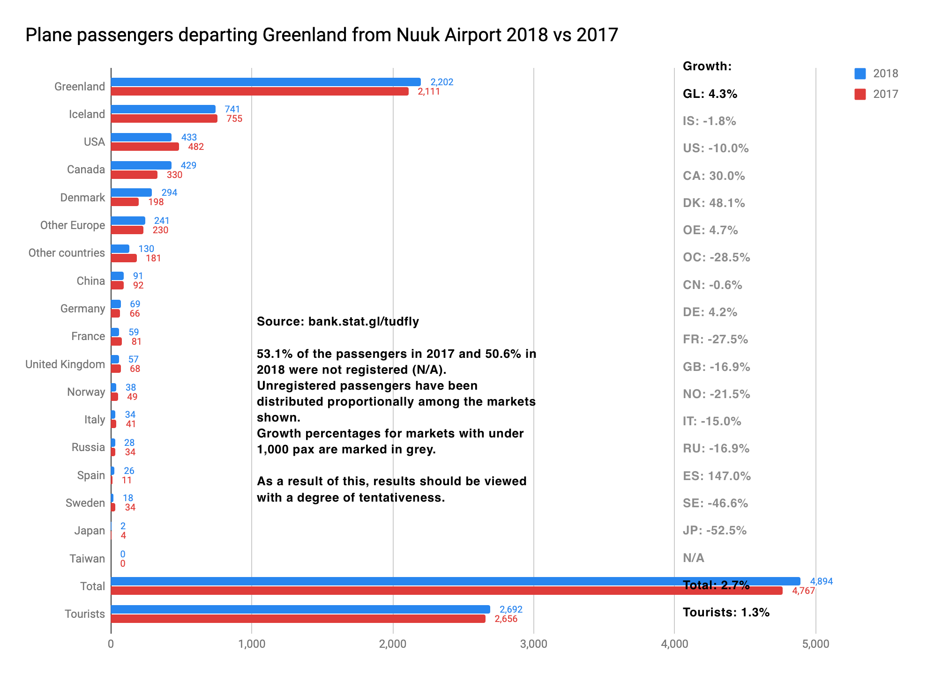
Flight Passengers Travelling Out of Greenland via Nuuk Airport
2018 has also seen challenges in terms of registration of the country of residence of the international passengers travelling out of Nuuk Airport, as under half have been registered. Otherwise, VG and Mittarfeqarfiit have a positive cooperation. The graph below must be taken with great reservations.
As mentioned in the graph the category “Unknown” (i.e. unregistered) has been distributed proportionally between all 18 segments in order to be able to compare with other years (where the same practice is applied).
Since the graph only represents approximately 10% of the passengers travelling out of Nuuk, it only says something about demand for the route Nuuk-Reykjavik (according to Mittarfeqarfiit there has only been registered country of residence on the Air Iceland Connect departures in 2018, and none on the Air Greenland departures), and not anything about general trends in the tourism in Nuuk. A growth of 1.3% on such a poor statistical foundation is not something to be used for any kind of conclusions.
In the national report one can see that Air Iceland Connect generally has had a decline of -12% in the number of international passengers between Iceland and Greenland in 2018. That is, however, not the case with the Nuuk-Reykjavik route.
Notes:
Flight Passengers Travelling Out of Greenland from Nuuk Airport 2018 vs 2017
Source: bank.stat.gl/tudfly
The category ”Unknown” has been distributed proportionally between the markets featured.
Thus 53.1% of the passengers in 2017 and 50.6% in 2018 were not registered.
Growth percentages for markets with less than 1.000 pax are marked in grey.
Due to the factors above the data must be taken with reservations.
(Venstre kolonne):
Greenland, Iceland, USA, Canada, Denmark, Other Europe, Other Countries, China, Germany, France, Great Britain, Norway, Italy, Russia, Spain, Sweden, Japan, Taiwan, Total, Tourists
(Kolonne til højre):
Growth:
GL: 4.3%
IS:-10,0%
CA: 30.0%
DK: 48.1%
OE: 4.7%
OC: -28.5%
CN: -0.6%
DE: 4.2%
FR: -27.5%
GB: -16.9%
NO: -21.5%
IT: -15.0%
RU: - 16.9%
ES: 147.0%
SE: - 46.6%
JP: 52.5%
N/A
Total: 2.7%
Tourists: 1.3%

Slide 4
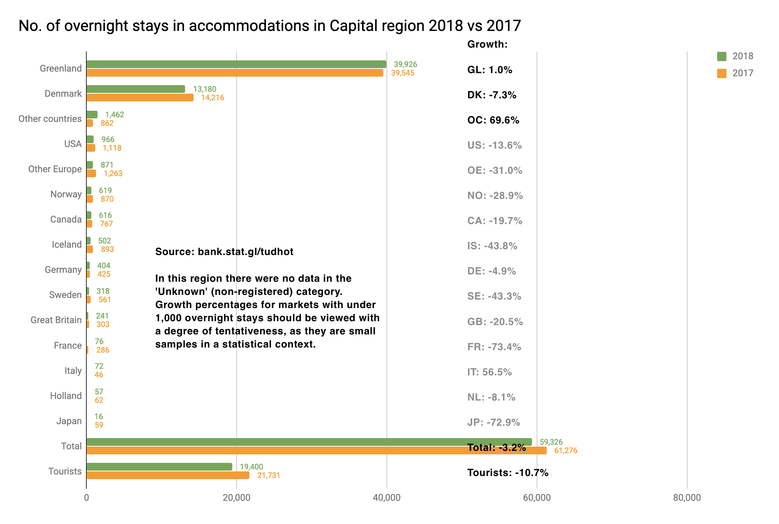
Number of Overnight Stays in the Region
Statistics Greenland has received overnight stay registrations for 68% of the bed capacity (in CVR registered accommodations) in Capital Region. In addition, there are some tourists in Nuuk who stay with friends and family or in an Airbnb apartment. VG has registered at least 20 Airbnb apartments in Nuuk, but it is likely there are more, which were just not visible on the Airbnb site at the time of the research.
There is a decline in the number of international overnight stays (incl. guests residing in DK) of -10.7% in 2018, which does not include data on other cities than Nuuk in Capital Region.
On the negative side the DK segment represents the largest decline with 1.036 fewer overnight stays, the equivalent of -7.3%.
The US segment’s 152 fewer overnight stays is the equivalent of -13.6%.
The Other Europe segment’s 392 fewer overnight stays is the equivalent of -31,0%.
On the positive side the Other Countries segment with an increase of 600 overnight stays the largest growth, the equivalent of 69.6%.
With 72 overnight stays – only 26 more than in 2017 – the Italy segment does not take up a lot of space. A growth percentage of a staggering 56.5% illustrates why it does not make sense to put too much emphasis on growth percentages when it comes to samples with under 1.000 overnight stays.
Notes:
Number of Overnight Stays in Accommodations in Capital Region 2018 vs 2017
Source: bank.stat.gl/
There were none in the category ”Unknown” (non-registered) in this region in 2017 and 2018.
Growth percentages for markets with less than 1.000 pax are marked in grey.
Growth percentages for markets with less than 1.000 overnight stays are to be taken with reservations and are thus marked in grey.
Kolonne til venstre:
Greenland, Denmark, Other Countries, USA, Other Europe, Norway, Canada, Iceland, Germany, Sweden, Great Britain, France, Italy, Holland, Japan, Total, Tourists
Kolonne til højre:
Growth:
GL: 1.0%
DK: -7.3%
OC: 69.6%
US: -13.6%
OE: -31.0%
NO: -28.9%
CA: -19.7%
IS: -43.8%
DE: -4.9%
SE: -43.3%
GB: -20.5%
FR: -73,4%
IT: 56.5%
NL: -8.1%
JP: -72.9%
Total: -3.2%
Tourists: -10.7%

Slide 5
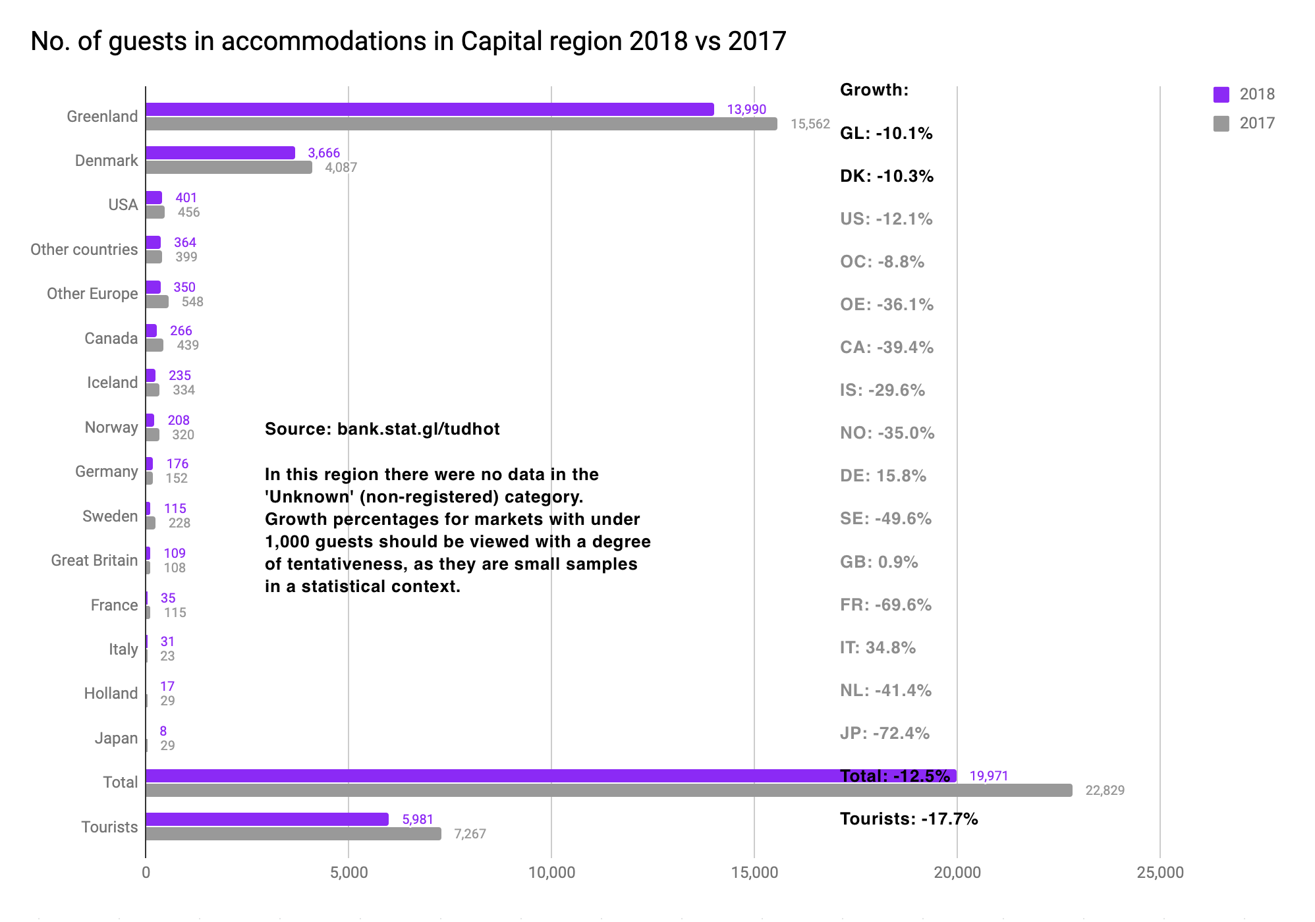
Number of individual Guests in the Region
In the accommodations in Nuuk which submit registrations there were 1.286 fewer international guests (incl. guests residing in DK) in 2018, the equivalent of a decline of -17.7%. On the following page one can observe in which months saw the largest decline compared to 2017. As mentioned 68% of the professional bed capacity in Capital Region that submits registrations. In addition there are likely a larger number of tourists with private overnight stays, incl. Airbnb, which we do not have data or any other indicators for.
When one looks at the graph it is significant how small a volume the international tourists are (i.e. excl. DK) compared with the GL and DK guests combined, which only represents approximately 12% of the total number of guests.
In comparison the share of international tourists in the other regions are as follows:
Avannaata/Qeqertalik 20%
Qeqqata 23%
Kujalleq 23%
Sermersooq Øst 74%
Either the international tourists are a little underrepresented in accommodations (that submit registrations) in Capital Region – or the guests residing in Greenland and Denmark are overrepresented depending on how one chooses to interpret the data.
Either way it looks like they take up less space in the streets than in the other regions, unless there are a larger amount that spend the night in other places than the accommodations that submit registrations in Nuuk.
Notes:
Number of Guests in Accommodations in Capital Region 2018 vs 2017
Source: bank.stat.gl/tudhot
There were no one in the category ”Unknown” (non-registered) in this region in 2017 and 2018.
Growth percentages for markets with less than 1.000 pax are marked in grey, as they are statistically small samples, thus they must be taken with reservations.
Kolonne til venstre:
Greenland, Denmark, USA, Other Countries, Other Europe, Canada, Iceland, Norway, Germany, Sweden, Great Britain, France, Italy, Holland, Japan, Total, Tourists
Kolonne til højre:
Growth:
GL: -10.1%
DK: -10.3%
US: -12.1%
OC: -8.8%
OE: -36.1%
CA: -39.4%
IS: -29.6%
NO: -35.0%
DE: -15.8%
SE: -49.6%
GB: -0.9%
FR: -69.6,4%
IT: 34.8.5%
NL: -41.41%
JP: -72.4%
Total: -12.5%
Tourists: -17.7%

Slide 6
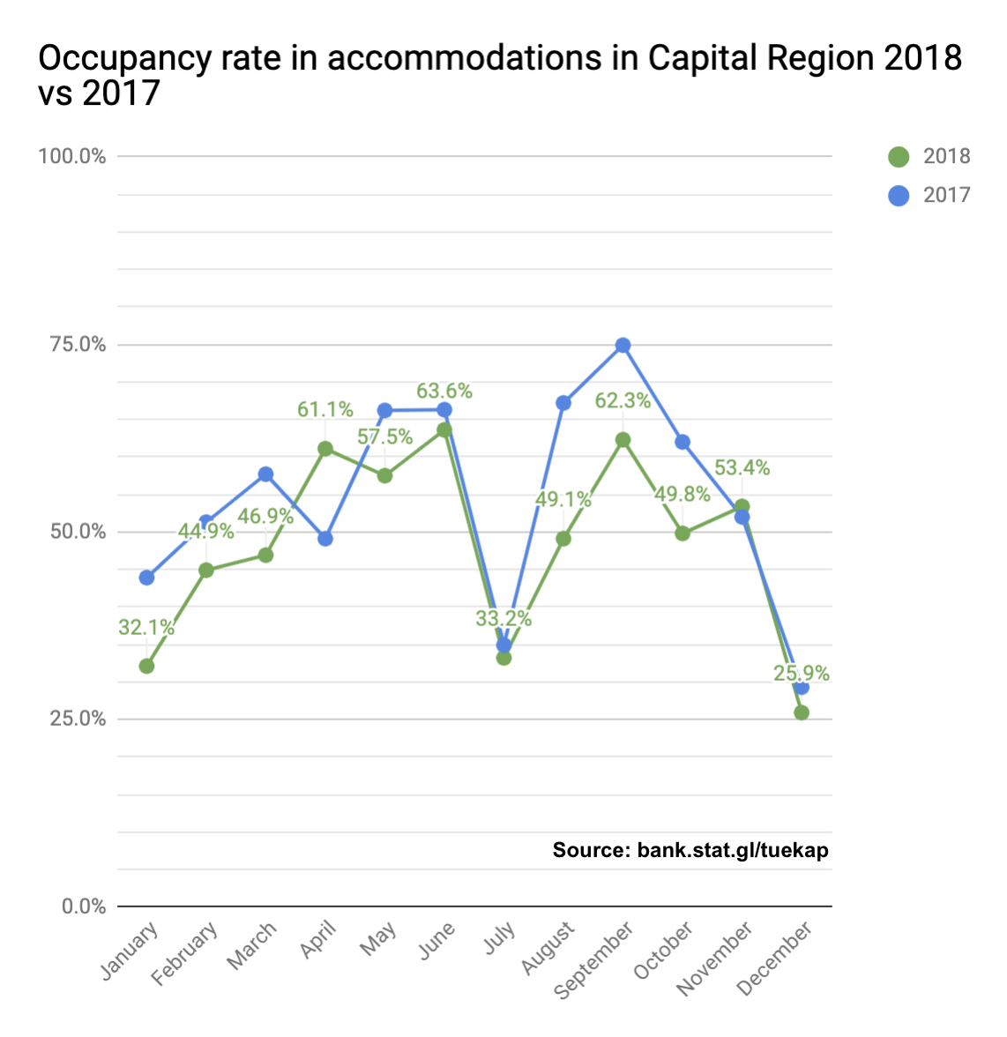
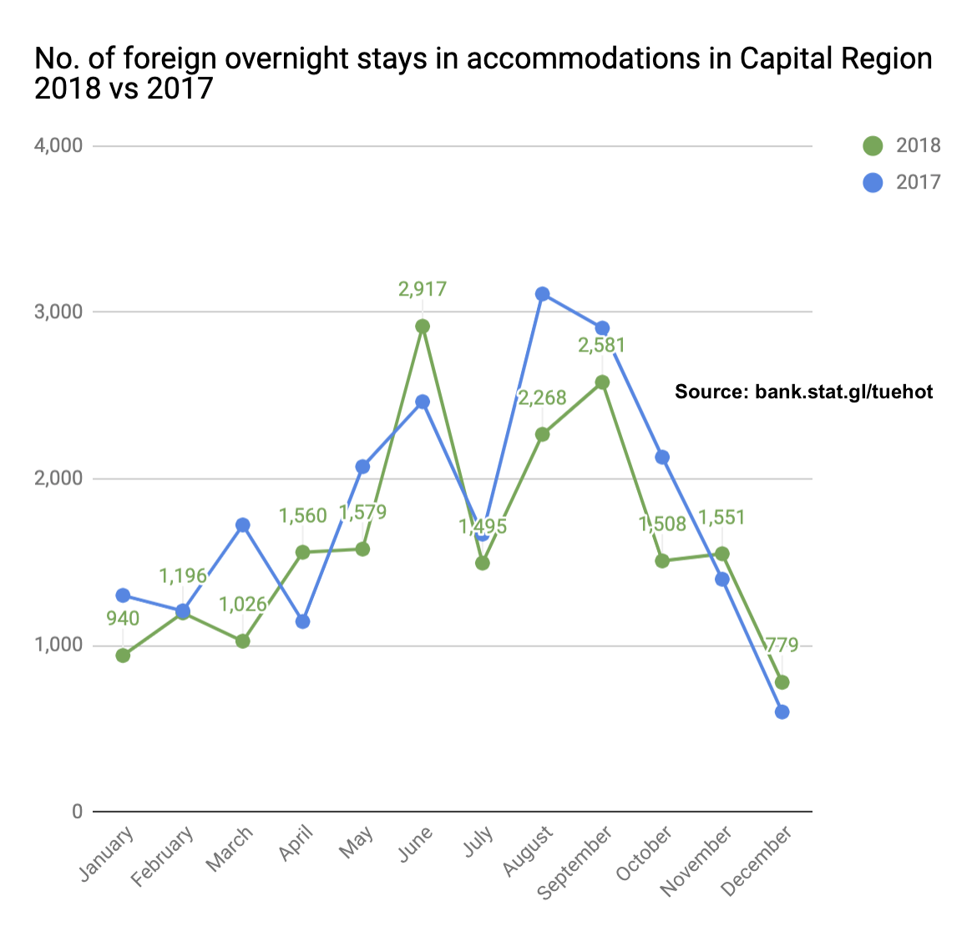
Occupancy Rate in Accommodations in the Region
The graph to the left shows occupancy rates for the total number of guests over the 12 months of the year in Capital Region. There is a fairly significant drop in July – both in 2017 and 2018. The data includes guests from all countries and so also those residing in Greenland. In several of the other regions there is a pattern reminiscent of a Mexican hat, i.e. a large degree of rented rooms in the summer high season from June through September, and a much smaller activity in the other months. In Capital Region it is practically only January, July and December which represent a very low activity.
The graph to the right only shows the number of international overnight stays (incl. DK) over the 12 months of the year. Here one can, once again, observe the significant drop in July, which one on the graph to the left might be tempted to believe was due to the absence of Greenlandic guests in the summer holiday. Capital Region was alone in this July drop compared with the other regions. That represents an untapped potential, as it should be possible to attract even more tourists in the month that is the busiest for the other regions in Greenland.
Notes:
Graf til venstre:
Occupancy Rate in Accommodations in Capital Region 2018 vs 2017
Source: bank.stat.gl/tudkap
January, February, March, April, May, June, July, august, September, October, November, December
Graf til højre:
International Overnight Stays in Accommodations in Capital Region 2018 vs 2017
Source: bank.stat.gl/tudhot
January, February, March, April, May, June, July, august, September, October, November, December

Slide 7
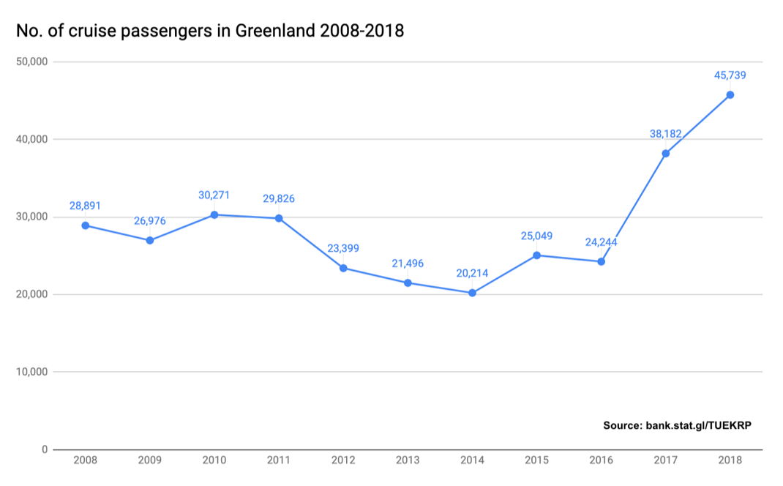
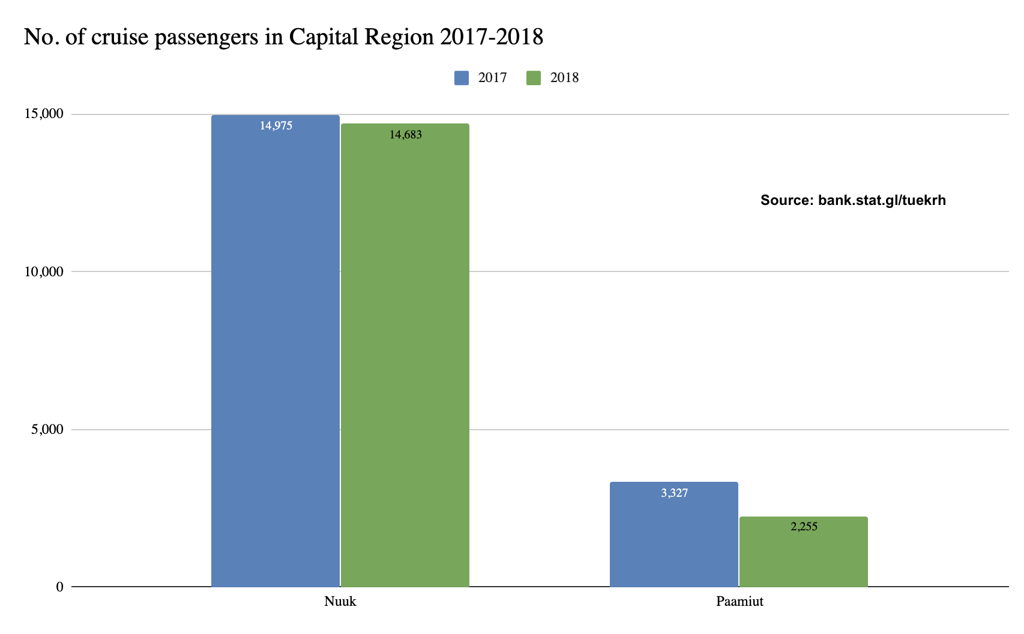
Cruise Tourism – Number of Guests 2008-2018
On the 27th of august 2019 Statistics Greenland published the 2018 cruise statistics. Publication was delayed due to some overdue submissions of port call registrations. On the same date revised figures for 2017 were published on bank.stat.gl/tudkrp. The new number (see the graph to the left) shows a significant increase in the number of passengers in 2017 and 2018, the equivalent of a 57.5% growth from 2016 to 2017 and a 19.8% growth from 2017 to 2018 nationally. Number on 2015 and 2016 are currently still being revised and can be expected to be adjusted upwards.
The graph to the right shows the number of passengers in Capital Region in 2017 and 2018. From 2017 to 2018 there was a combined decrease of -7.5% in relation to the number of passengers. In the light of the significant growth nationally, it can seem illogical, but one must bear in mind that the timetables of the cruise lines have varied greatly through the past few years, and thus the decline in Capital Region can likely be attributed to natural variations in the market, more so than as a sign of a decline in demand for the region.
Notes:
Graf til venstre:
Number of Cruise Passengers in Greenland 2008-2018
Source: bank.stat.gl/tudkrp
Graf til højre:
Number of Cruise Passengers 2017 and 2018 in Capital Region
Source: bank.stat.gl/tudkrh

Slide 8
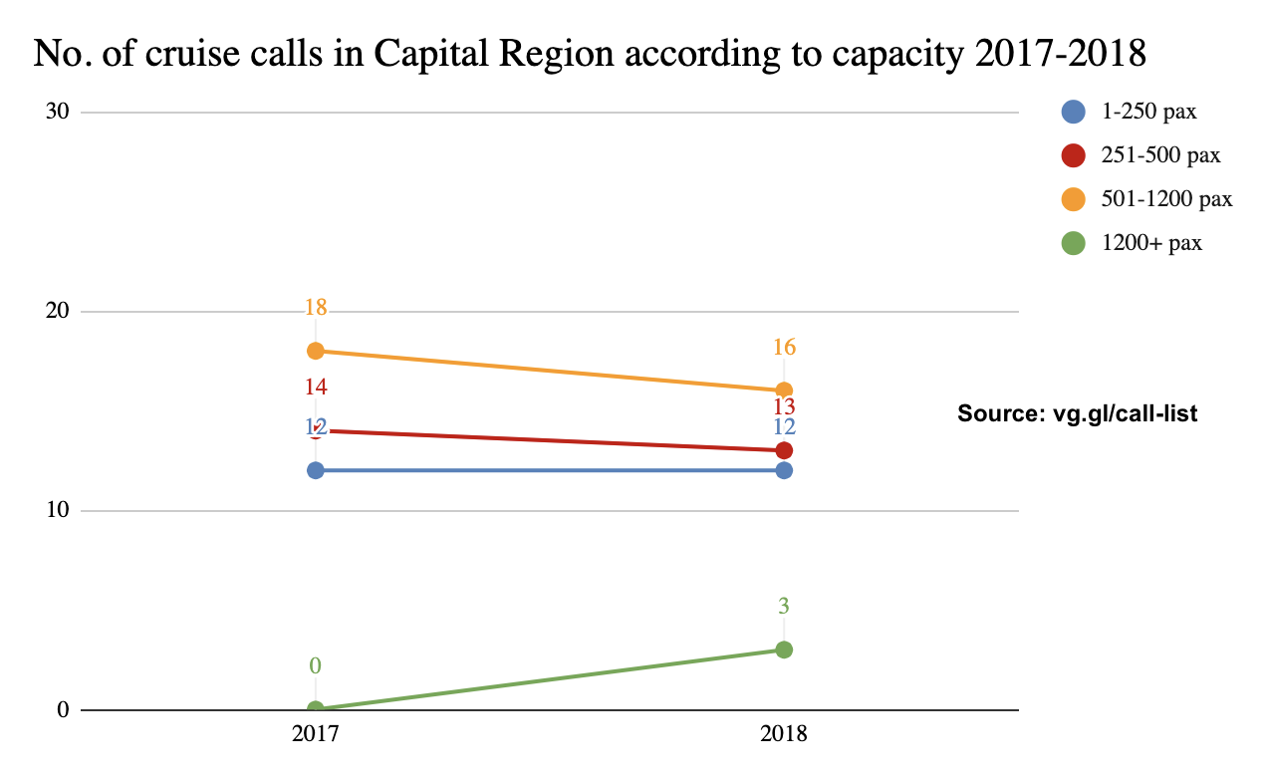
Cruise Tourism – Number of Port Calls According to Capacity 2017-2018
The graph below shows the number of port calls i Capital Region in 2017 and 2018 by the 4 so called “pax classes”, i.e. according to passenger capacity on the ships. From 2017 to 2018 there was a decrease in the two middle pax classes, but an increase from 0 port calls in 2017 to 3 in 2018 for the largest 1200+ class. The smallest pax class remained at status quo.
The 3 port calls by 1200+ ships in 2018 were Rotterdam (1.401 pax) on the 25th of July 2018 i Paamiut, Oriana (1.880 pax) the 1st of August 2018 in Nuuk and Zuiderdam (1.916 pax) the 5th of September 2018 in Paamiut. Nationally there is a trend of more port calls by the large class 1200+ pax ships and thus this trend can also be observed in Capital Region.
Experience shows that there has been some variation from year to year in relation to what ships call on Greenland and where in Greenland they sail, so on a regional level there can easily be growth in one region, while there is a decline in the other.
This was also the case in 2018 where there was growth in Qeqqata and Kujalleq, while a decline could be observed in Sermersooq East, Capital Region and Avannaata-Qeqertalik (still linked due to old data series until new data series that separates them are initiated).
The relatively large growth nationally is likely caused by the change in port fees that was put into effect from the 1st of January 2016, which gives the ships huge savings on port calls in Greenland. This is especially true for the ships in the 1200+ pax class, where the savings can be in the amount of several hundred thousands of DKK per cruise.
A smaller ship in the 1-250 pax class will, however, still save mange thousands of DKK per cruise compared to the previous port fee that was charged as 525 DKK per passenger.
Notes:
Number of Port Calls in Capital Region According to Passenger Capacity 2017 and 2018
Source: vg.gl/call-list

Slide 9
Final Thoughts
Based on the data at hand 2018 looks to have been a less good year in terms of tourism development in Capital Region. This must, however, be taken with reservations due to incomplete data in relation to flight passenger data and overnight stay data.
Nationally the overall picture is more positive with approximately 3% more international guests flying out of the country in 2018, and a growth in the cruise tourism of 19.8%.
At the time of preparation of this report (due to delayed cruise data), overnight stay data has been released for the first half of 2019, and here is an increase of 8.5% in the number of international overnight stays in Capital Region. It must be taken with the reservation that first half of the year normally represents less than 44% of the total number of guest that visits Capital Region each year, so it is not a solid indicator for the tourism development in 2019. We will have to wait for the numbers on all of 2019. It does, however, illustrate that the decline in 2018 may represent a temporary negative fluctuation in the market.
UNWTO predicts a continued global average growth in tourism of approximately 4% in the coming years, so there is no apparent reason to fear a long lasting decline. Data on the first 8 months of 2019 in Iceland (statice.is) does, however, show for the first time in many years a decline in the number of international passengers through Keflavik of -13.4%. This is partly because of the bankruptcy of WOW Air resulting in fewer incoming flights, but there has been some talk in the industry as well as in international articles about “mass tourism”, and there are indications that Iceland is not quite as hot anymore.
That is not necessarily a trend that is negative for Greenland, as the adventure tourists are always on the lookout for new 2undiscovered” and less crowded destinations. Of course, this still requires targeted work on marketing, product range and pricing.
The capacity analysis by Visiobox shows that with a 5% growth per year it will only be a handful of years before there will be capacity limitations in Nuuk both in regard to accommodation and restaurants. And if the opening of the extended airport will boost demand even further, so much more the reason to focus on a capacity increase in the coming years.
Best regards
Visit Greenland
Compiled by Mads Lumholt, Visit Greenland, September 2019

