Slide 1
Tourism Statistics Report 2019
North Greenland

Slide 2
Introduction
2019 marked the year of the first symbolic blast in connection with the construction of the coming 2,500 meter airport in Ilulissat, paving the way for the possibility that one from the end of 2023 can fly directly to Disko Bay from Copenhagen, and in time from other international hubs. Thus, there is likely a need to adjust the destination management over the coming 3 years – i.e. accommodation, dining options, tours and other relevant services to accommodate the increased amount of tourists that will likely arrive once the new airport is up and running.
On a national level 2019 saw both positive and negative developments and indicators. The only data we have on Qeqertalik Municipality (Aasiaat, Qasigiannguit, Qeqertarsuaq and Kangaatsiaq) alone is cruise data, as the overnight stay data for now remains included in the data series for the former Qaasuitsoq Municipality, and there are no international departures from Aasiaat Airport. The number of tourists remains so low that even a variation of a few more or less from a specific country segment will cause disproportionate percentage differences from one year to the next, so growth percentages can easily be overinterpreted Furthermore there is a natural variation in the demand from the international adventure market, which must also be kept in mind.
It is therefore most appropriate to look at the development in tourism in Greenland on a national level and over a period of 5 or 10 years, as this is where we can read trends more clearly. Thus we can conclude that tourism in Greenland in the 4-year perspective from 2015 through 2019 (we only have country of residence data on flight passengers since mid-2014) has been growing, both in terms of land-based tourism and cruise.
In 2015 we registered approximately 51,803 international flight passengers travelling out of Greenland incl. the DK segment. In 2019 we registered approximately 58,149 international flight passengers, which is a growth of 12.3 %. That is equivalent to an annual growth of approximately 2.9 %. It is slightly under the average annual global tourism growth in the same period, but is must still be considered a healthy development. But all normality is suspended due to covid-19 in 2020 but let us hope that we may soon begin to gradually work our way back to a somewhat normal tourism market again.
This report focuses specifically on 2020 data for North Greenland and thus one must keep in mind that it is largely only the overnight stay statistics that provides solid indications on the tourism development in the region, as data on the number of international flight passengers on direct flights to Iceland, travelling out of Ilulissat Airport, only account for a small portion of the tourists travelling out of the region on their way to their country of residence. More than ¾ of the tourists fly via Kangerlussuaq, where they are registered according to country of residence.

Slide 3
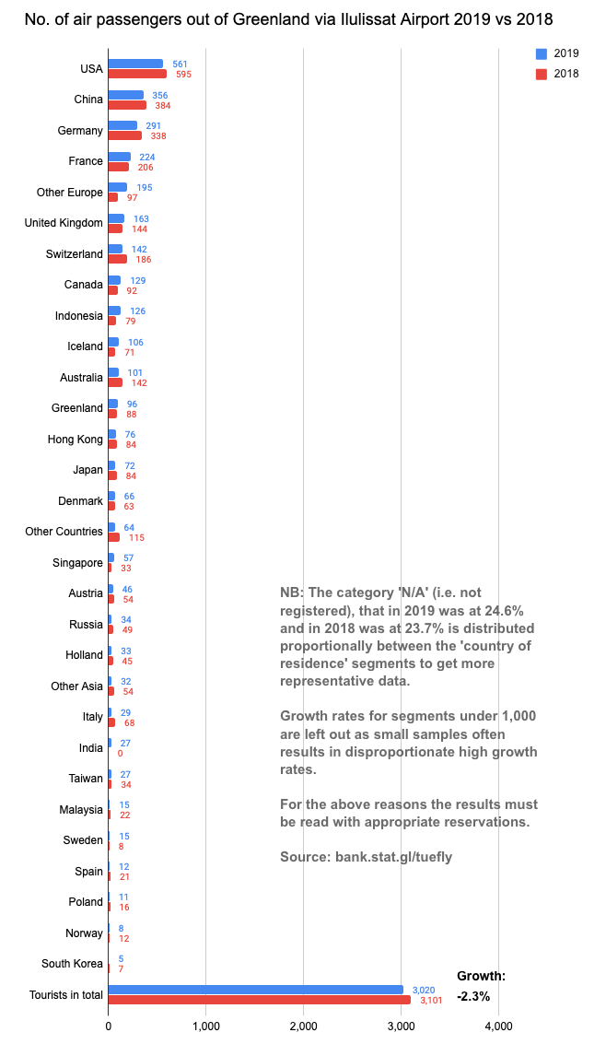
Flight Passengers Travelling Out of Greenland via Ilulissat Airport
From the largest segment registered in Ilulissat Airport, USA, 561 passengers travelled out of Greenland via Ilulissat, while 1,800 travelled out via Kangerlussuaq. In the 2nd largest segment China 356 passengers travelled out of Greenland via Ilulissat Airport, while 660 travelled out via Kangerlussuaq. In the 3rd largest segment Germany, 291 travelled out of Greenland via Ilulissat Airport, while 3,560 travelled via Kangerlussuaq.
In the DK segment, which makes up approximately half of the tourists in Greenland over the year, only 66 passengers travelled out of Greenland via Ilulissat Airport, while 26,021 travelled out via Kangerlussuaq.
As one can see, the majority of the tourists that visit North Greenland travel out of the country via Kangerlussuaq, and thus one must take the numbers in the graph on the left with great reservations.
Furthermore, there are no segments with over 1,000 individuals. In other words, we are dealing with statistically small samples, and thus growth rates are not noted in other categories than the total number of tourists.
A total decline in the number of international flight passengers travelling out of Ilulissat of -2.3 % is of course in itself a cause for some thought, but we must at the same time remember that it is only a case of 73 fewer passengers than in 2018.

Slide 4
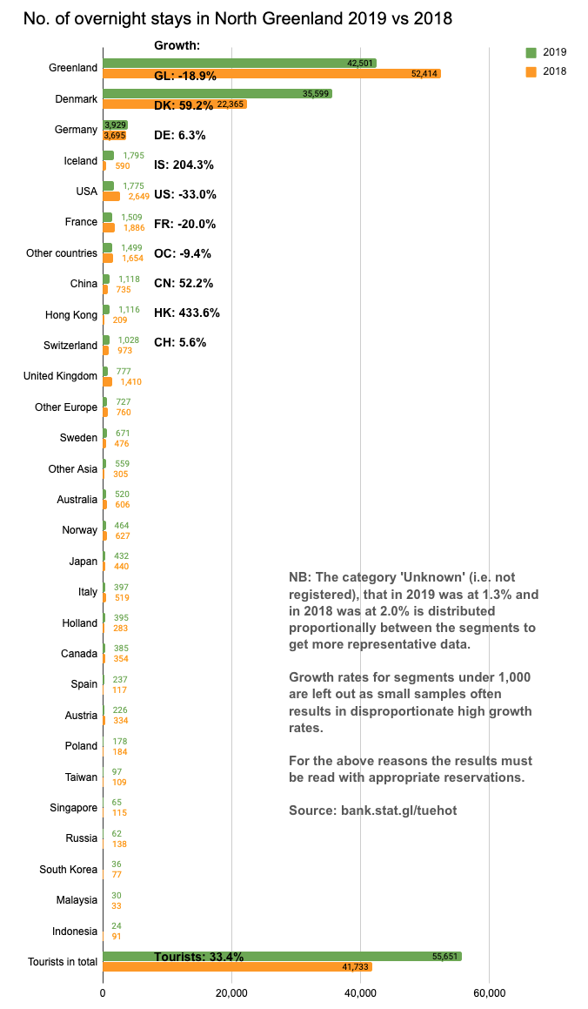
Number of Overnight Stays in the Region
A significant growth in the DK (59.2 %) and IS (204.3 %) segments characterizes the 2019 season in North Greenland. As we do not have access to information on concrete events (courses, conferences etc.), we can only assume that a certain share of these overnight stays are related to business related activities, which can be in many different contexts, among other things the Isfjord Centre and the future airport.
The business related overnight stays still fall under the UNWTO’s definition of what ‘tourism’ is: ”Tourism comprises the activities of persons traveling to and staying in places outside their usual environment for not more than one consecutive year for leisure, business and other purposes”.
It is primarily the growth in the DK and IS segments that result in an overall growth in tourists of 33.4 %.
If one excludes DK and IS from the tourist segments 2019 saw a small decline in the number of international overnight stays of -2.8 %.

Slide 5
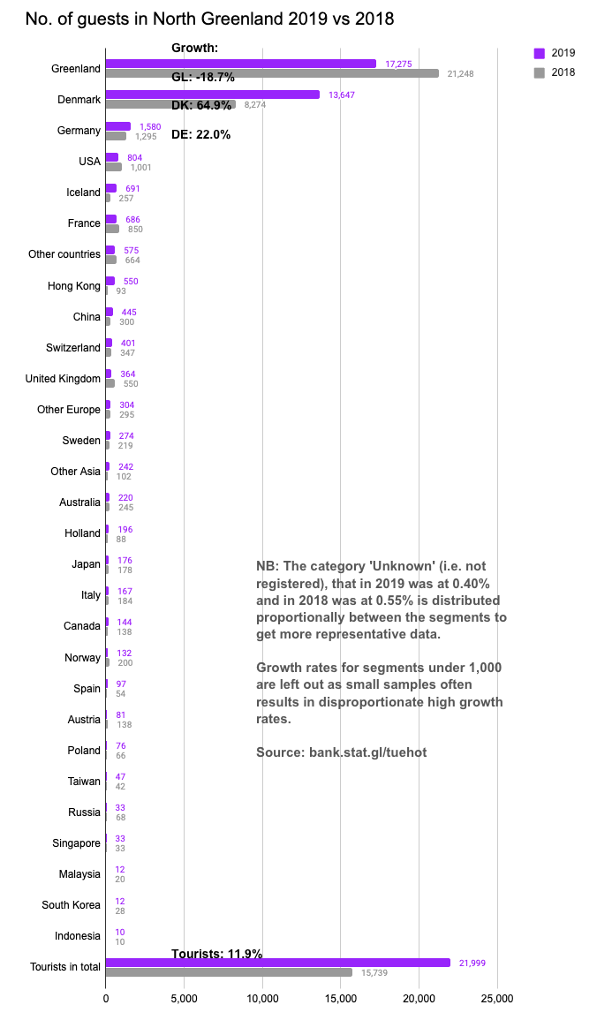
Number of Individual Guests in the Region
As is the case with regards to international overnight stays (previous page) one can note a significant growth in the DK and IS segments, which is likely connected with the increased business activities in the region. The significant growth in the DK and IS segments means that the total growth is 39.8 % for the tourist segments combined.
If one excludes the DK and IS segments the growth in international guests was 6.3 % in 2019.
DE is the 2nd largest segment after DK and represents a growth of 22.0 %, which is quite positive.
Slightly surprisingly the segment Hong Kong is the 6th largest tourist segment. Switzerland coming in as the 8th largest segment is also a surprise. Both segment are not included in the bank.stat.gl/tudhot data series, which dates back to 1994, which is due to the fact that it was not until the 1st of January 2016 that registrations of the segments HK, CH, ØA, AU, ES, AT, PL, TW, RU, SN, MY, KR and ID began.
The 13 new segments are not included in the bank.stat.gl/tudhot data series, so as to have a database with the exact same nationality history since 1994.

Slide 6
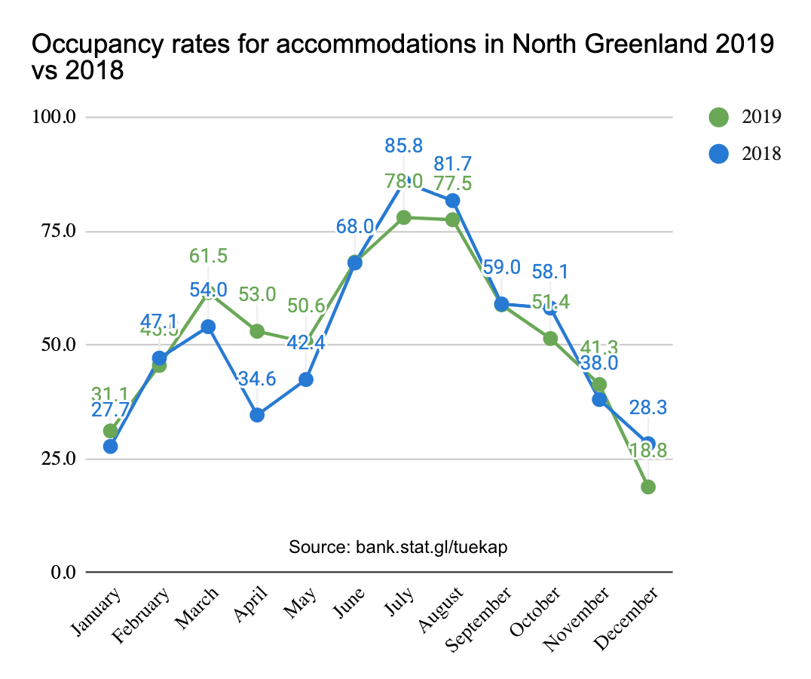
Occupancy Rate in Accommodations
Occupancy rate is the term for how many rooms have been rented out per month compared to the total number of rooms available in the given moon, for accommodations in North Greenland (the graph to the left) and Ilulissat (the graph to the right) respectively. As the vast majority of the rooms in accommodations contains 2 beds, this data type speaks more to the sales development over the 12 months than it does to the number of individual guests, as we do not know when 1 or 2 people at the time have stayed in the rooms.
For this data type we have access to data on both the entire region and Ilulissat, as the latter includes so many accommodations that the confidentiality principle can still be observed. In 2018 both data sets are characterized by a significant decline in April-May compared with 2019. In other words, the season development is less favourable in 2018 than in 2019. However, both data sets show a weaker summer high season in 2019 than in 2018.
Note: These graphs contain data on both international guests and guests residing in Greenland combined. This data level does not distinguish between nationalities.
The following page focuses on the season development for international guests (incl. DK), but the occupancy rates are not shown.

Slide 7
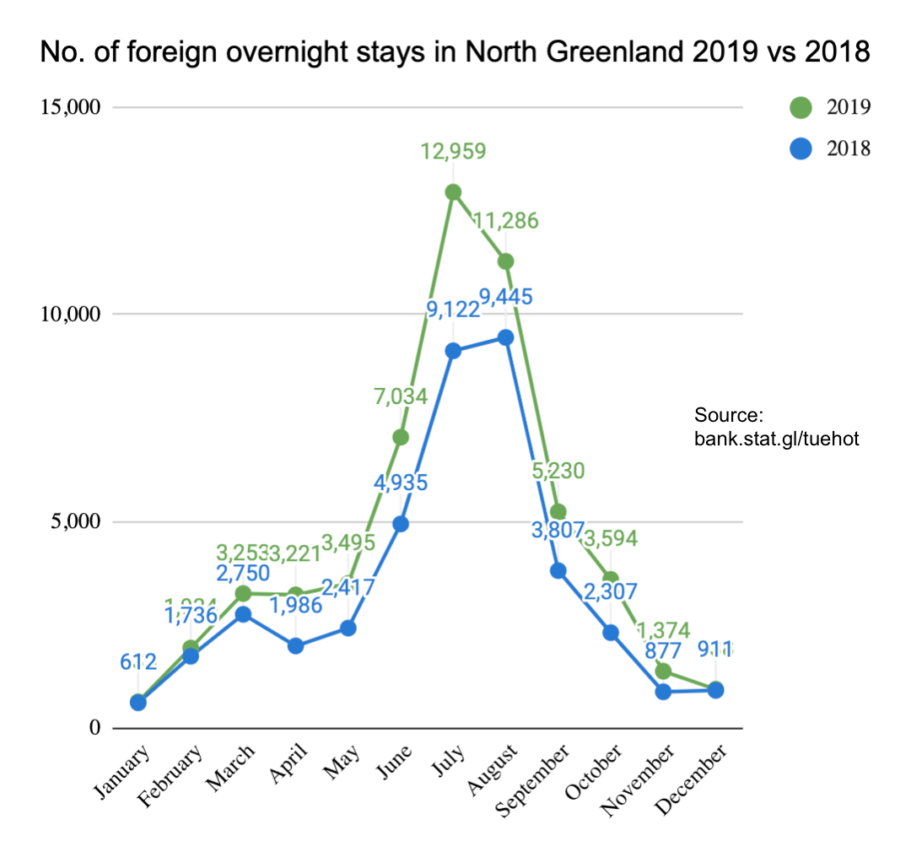
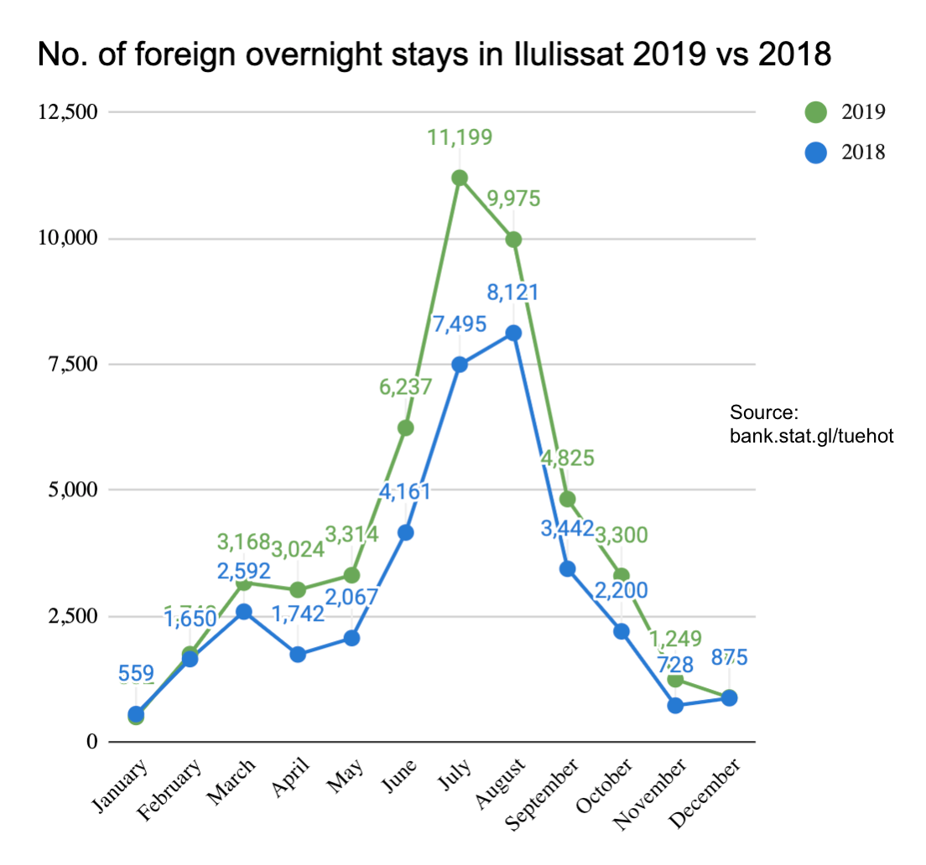
Seasonal Variation in Accommodations
Below one can see the number of international overnight stays in North Greenland (left) and Ilulissat (right) respectively. If one compares the graphs on this page with the corresponding graphs on the previous page, one can see a steeper summer high season here. This is because the data below only includes international overnight stays (i.e. excl. GL citizens). GL citizens are more likely to stay out of the summer high season, which corresponds well with the fact that they primarily are business guests.
As one can see there is little difference between the left and right graphs, which means that data from Ilulissat is all-dominant in the statistics. This is due to the large overnight capacity compared with the rest of North Greenland, which unsurprisingly, has to do with the fact that Ilulissat, by far, is the largest tourist destination in Greenland.

Slide 8
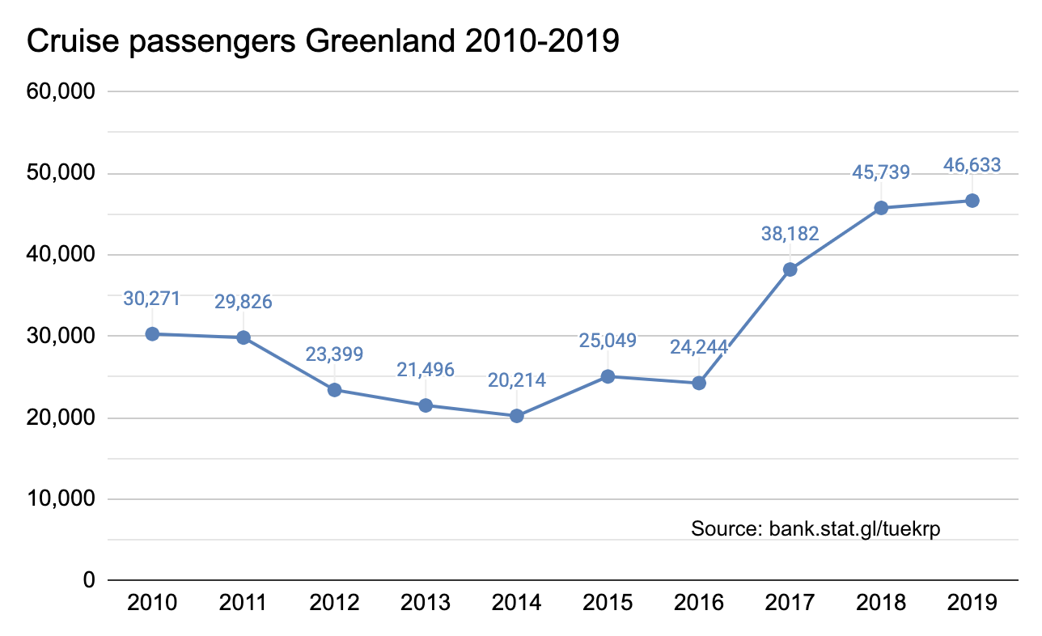
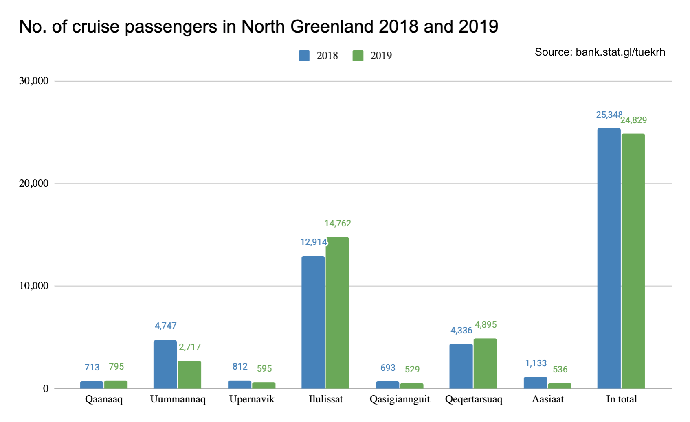
Cruise Tourism Nationally and in the Region
The global cruise industry pre the Covid-19 crisis was one of the largest growth areas in tourism, but the annual growth rates which, in the period 2019-2026 would be approximately 10 % according to datamintelligence.com – are estimates from before the Covid-19 outbreak.
Now in the course of a few months the situation is completely changed and at present (May 2020) the cruise line association CLIA has voluntarily chosen to suspend all cruises in 2020 for now, and it is not at present time clear when they will open up again. There will likely be large differences from country to country with regards to which safety measures the cruise lines must operate under once they reopen their cruises.
As for the total number of passengers on port calls in Avannaa/Qeqertalik the 24,829 passengers in 2019 are equivalent of a decline of -2.1 % compared to 2018.

Slide 9
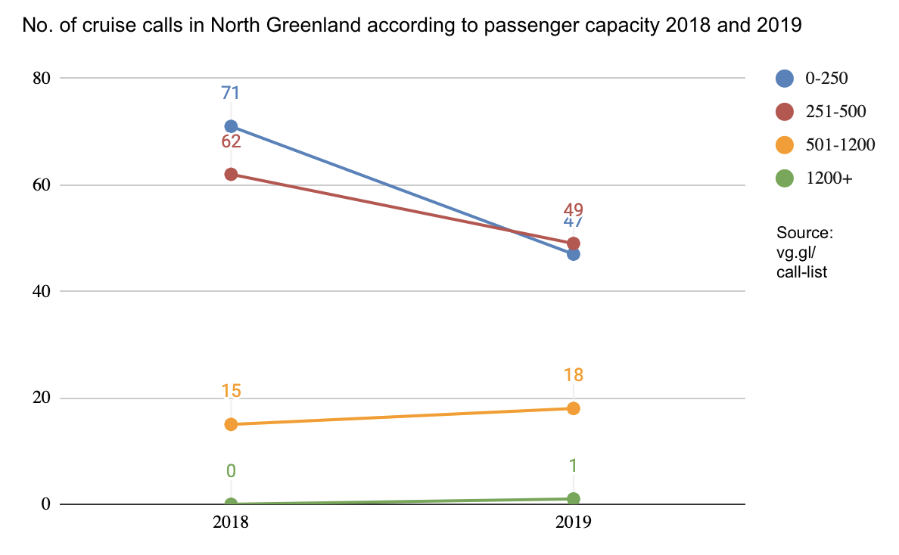
Cruise Tourism – Number of Port Calls According to Capacity 2018-2019
The graph below shows the number of port calls in North Greenland in 2018 and 2019, according to the 4 so-called ‘pax classes’ – i.e. by the passenger capacity of the ships. From 2018 to 2019 there has been a large decline in the 1-250 pax class from 71 to 47 port calls, and likewise a large decline in the 251-500 pax class from 62 to 49 port calls. In the second largest 501-1,200 pax class there was an increase from 15 to 18 port calls, and in the largest pax class there was just one port call in 2019 vs. none in 2018.
Even though there was a significant decline in the two smallest pax classes, the total decline in the region with regards to the total number of passengers was a ‘mere’ -2.1 %, which is due to the fact that the lone port call made by MSC Orchestra with a capacity of 3,200 passengers was quite decisive in positive direction in terms of quantity.
There was a total of 115 port calls in 2019 vs. 148 port calls in 2018, in other words a decline in the number of port calls of -22.3 %.
It is therefore not the number of port calls that matters most for how many passengers have had the opportunity to come ashore, but rather how many passengers have been onboard ships that have made port calls. From a 2015 cruise survey we know that 98 % of the passengers came ashore at least once during their cruise in Greenland, which often consists of between 2 to 5 port calls.

Slide 10
Final Thoughts
A total increase of 33.4 % in the number of tourist overnight stays sounds extraordinarily positive, but we must remember that it is first and foremost due to a significant growth for DK (59.2 %) and IS (204.3 %) segments, which for the majority is likely due to an increased activity for business visitors in the region. If one excludes these two segments there was a decline in the number of tourist overnight stays of -2.8 % in 2019. Unsurprisingly, the number of individual international guests somewhat follows the same pattern.
The season development in the region is still not quite desirable, as more than half of the tourists still arrive in Q3 alone. An effort should be made to increase demand for the other 3 quarters, so as for the development to be more financially and socially sustainable. A more even demand over all the seasons can ensure more year-round jobs in tourism and improve the financial footprint on the regional economy.
The decline of -2.3 % in the number of international flight passengers travelling out of Ilulissat Airport mainly speaks to the demand for the route Ilulissat-Reykjavik, rather than to the number of land-based tourist that have visited the region, as the passenger number only represents approximately 18 % of the total passenger volume out of Ilulissat Airport. At present we unfortunately do not have data on how many passengers on the route Ilulissat-Kangerlussuaq are checked through to Copenhagen, but experience tells us that it is the vast majority.
A small decline in the number of cruise passengers of -2.1 % for North Greenland from 2018 to 2019 can likely be attributed to variations in the sailing plans of the cruise lines from year to year, which can cause large fluctuations. When one looks at the significant growth in cruise tourism nationally, it is unlikely that it is due to a decrease in demand for the region. It must be attributed to, the more or less, natural variations in the cruises on offer and the sailing plans of the cruise lines from year to year.
We wish you all the best possible 2020 season despite the Covid-19 crisis!
Best regards
Visit Greenland
Compiled by Mads Lumholt, Visit Greenland, May 2020

