Slide 1
Tourism Statistics Report
2019
South Greenland

Slide 2
Introduction
2019 was a year with a quite positive development for the region South Greenland. The number of international flight passengers (incl. The DK segment) increased by 2.9 %. The number of international overnight stays went up by 1.1 %. However, there was a small decline in the number of international guests (incl. DK) of -0.7 %.
In regard to cruises there has been a growth in the number of cruise passengers, which had the opportunity to come ashore and purchase services and goods in 2019, the equivalent of 17.9 %, which is significant especially since the growth on a national level was a ‘mere’ 2.0 %.
The increase in the number of cruise passengers visiting South Greenland is primarily due to a large increase in the number of port calls for ships in the 501-1200 pax class (from 25 in 2018 to 39 in 2019) as well as an increase in the number of port calls in the 1-250 pax class (10 in 2018 to 22 in 2019).
There is a certain statistical uncertainty in regard to the data at hand, as there is possibly a share of tourists that have ‘flown under the radar’ for example by travelling out of the region via the Narsarsuaq-Nuuk or Narsarsuaq-Kangerlussuaq routes, where they are not registered by country of residence before Nuuk or Kangerlussuaq. Passengers travelling in and out of the region via Sarfaq Ittuk are not registered either. Furthermore, there are shadow figures when it comes to the number of guests sleeping under open sky, at friends’ places or in accommodations that do not submit registrations.
But overall, based on the data at hand we must conclude that there were more positive indicators than negative, especially with regards to cruises.
Visit Greenland and the Government of Greenland has joined forces on the tourism strategy for 2020-2023, which includes the opening of 3 new international airports in Ilulissat, Nuuk and Qaqortoq. They are scheduled to open in the autumn of 2023. The 3 years leading up to the opening of the new airport in Qaqortoq must also focus on preparing the destination management – i.e. accommodations, transportation, tours and other tourism supporting elements – in order for everything to be scaled according to the expected amount of tourists from 2023 and onward.
At present it is not entirely clear how many more tourists one can expect, particularly in Qaqortoq after 2023, but one could consider creating a number of hypothetical scenarios, which would better allow for an appropriate adjustment of the destination management. The closer we come to the opening, the clearer it will be how many tourists one can expect.

Slide 3
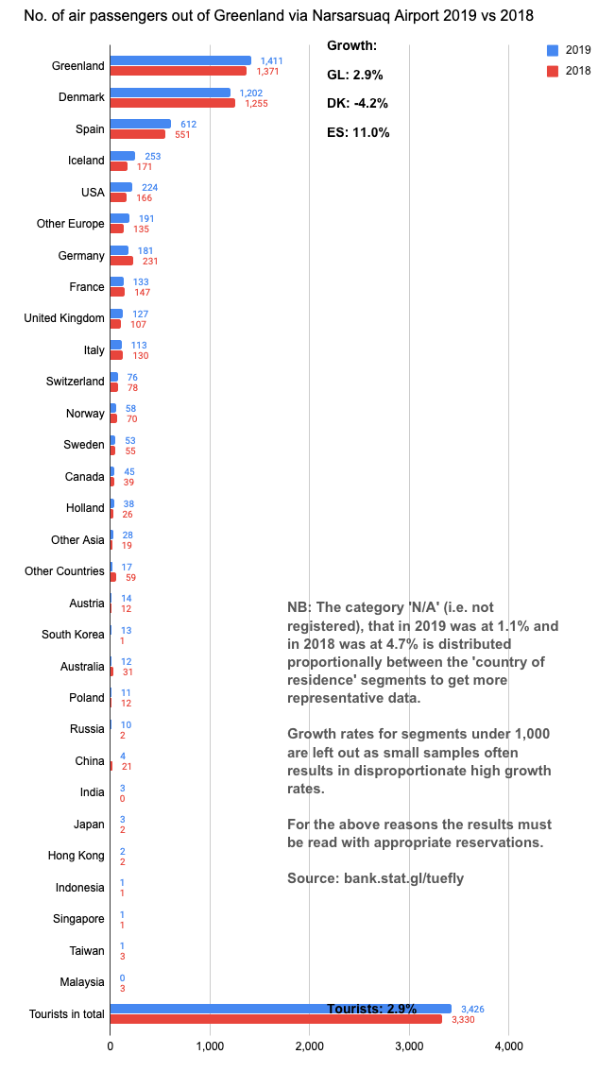
Flight Passengers Travelling Out of Greenland via
Narsarsuaq Airport
For the first time we are able to show all the 30 segments that have been registered since January 2016 – plus the segment India, which has been registered since January 2019. At bank.stat.gl/tudfly only the segments registered since 2008 are shown. Not all the ‘new’ segments are added to the data set, as it would break history. A new data set including all the 30 segments will be added eventually.
Growth rates for samples under 1,000 are not statistically valid, thus they are left out, but the graph to the left shows that the following segments experienced growth: ES, US, Other Europe, GB, CA, NL, Other Asia, AT, KR, RU, IN and JP. However, the number in most segments is very modest.
It is likely that a certain share of tourists arrives in South Greenland via the Air Greenland Nuuk-Narsarsuaq route as well as on the Sarfaq Ittuk, unfortunately, we do not have any data on this.

Slide 4
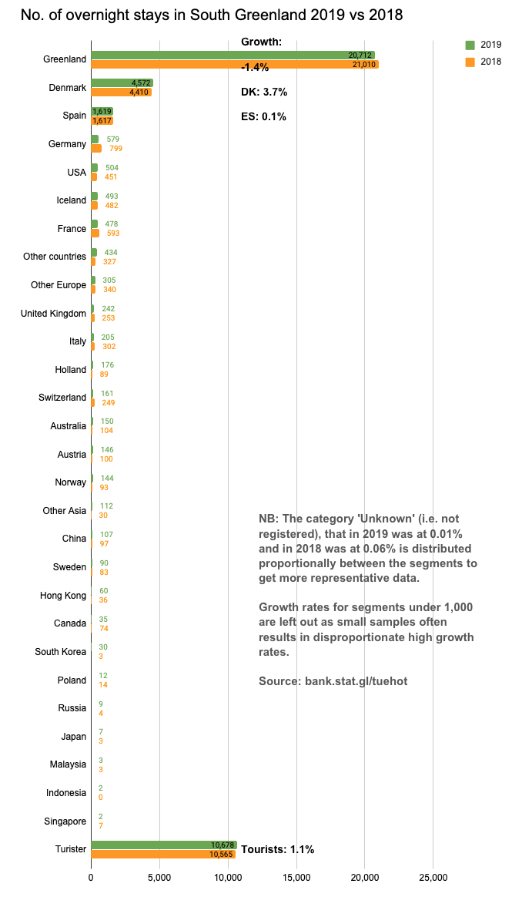
Number of Overnight Stays in South Greenland
Regarding accommodations we are, for the first time, able to show an additional 14 segments more than the 15 that are a part of the bank.stat.gl/tudhot data series. As opposed to the flight passenger registrations we will unfortunately not be including India as a segment in the foreseeable future, but as the previous page showed at present this segment remains rather insignificant.
Out of the ‘new’ segments Switzerland (CH) had the most overnight stays (249 in 2018 and 161 in 2019) followed by Australia (104 in 2018 and150 in 2019) and Austria (100 in 2018 and 146 in 2019).
Japan, which has been registered since 1994, is the negative surprise with only 3 overnight stays in 2018 and 7 in 2019. Canada and Sweden also had relatively few overnight stays in both 2018 and 2019.
In South Greenland registrations are submitted for approximately 80 % of the bed capacity (counted in number of beds available). However, it only applies to accommodations that are CVR-registered as such. Aside from these there is a small number of private homes that acts as accommodations, mainly booked via airbnb.com.
However, the region is known for its fantastic hiking options, and thus one must keep in mind that all the people who sleep under open sky are not registered either.

Slide 5
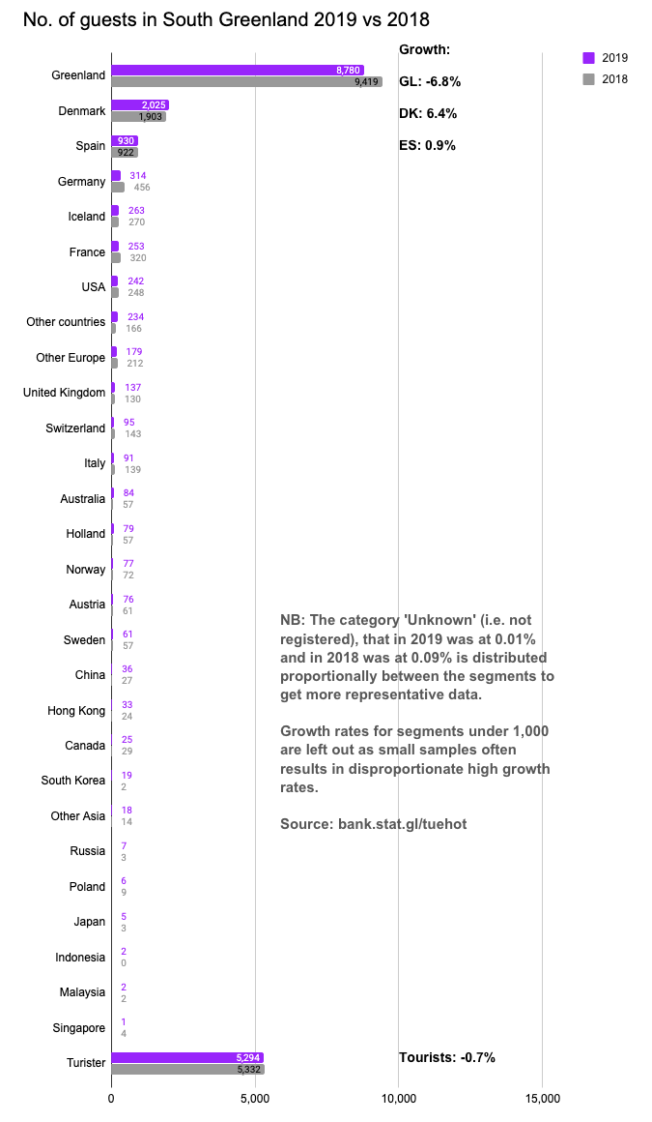
Number of Individual Guests in South Greenland
The growth in the number of unique international guests largely corresponds with the number of international overnight stays – which is not always the case. A given segment can, for whatever reason, have bought 2.3 overnight stays per guest one year vs. perhaps 2.1 overnight stays the following year.
The average number of overnight stays bought varies slightly from year to year from segment to segment and region to region. The average for all international segments in South Greenland (incl. DK) was 2.0 both in 2018 and 2019. The national average was 2.7 and 2.6, respectively.
What is special about South Greenland regarding the distribution of segments is that Spain is the 2nd largest segment in this region. Among other things this is due to the presence of Spanish-owned tourist operators (Tasermiut and Arctic Yeti) which have established themselves here, which we have only witnessed in a shorter period in North Greenland, where PGI Greenland for a while operated a kayak centre in Oqaatsut.
In South Greenland the ES (Spain) segment make up 46 % of the size of the DK segment, where the second largest tourist segment nationally, DE (Germany) only make up 13.5 % of DK’s size. Thus, one must not underestimate the importance of the ES segment for South Greenland.

Slide 6
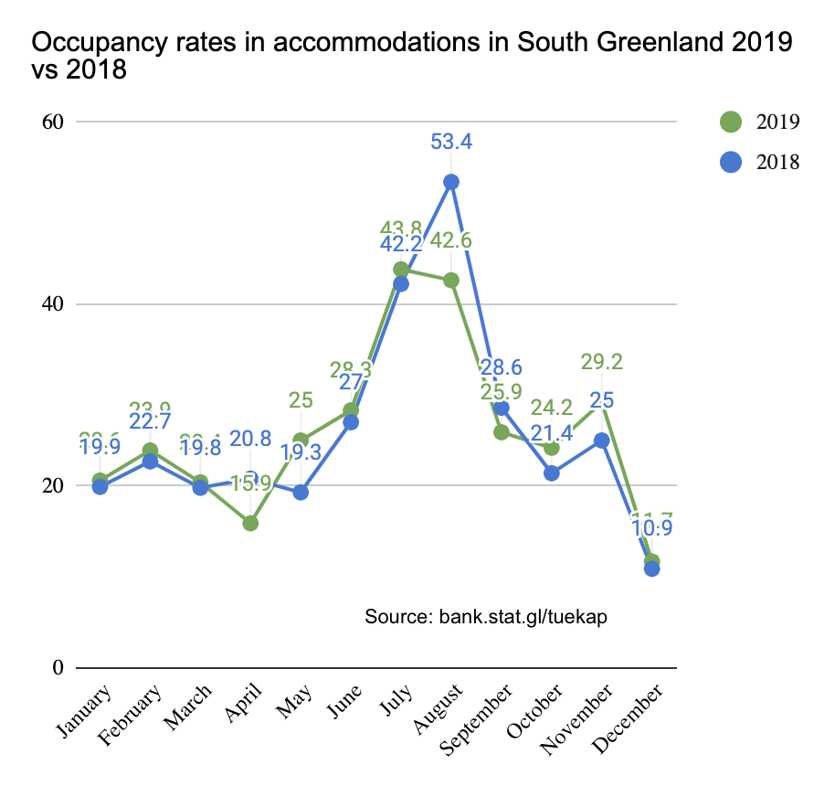
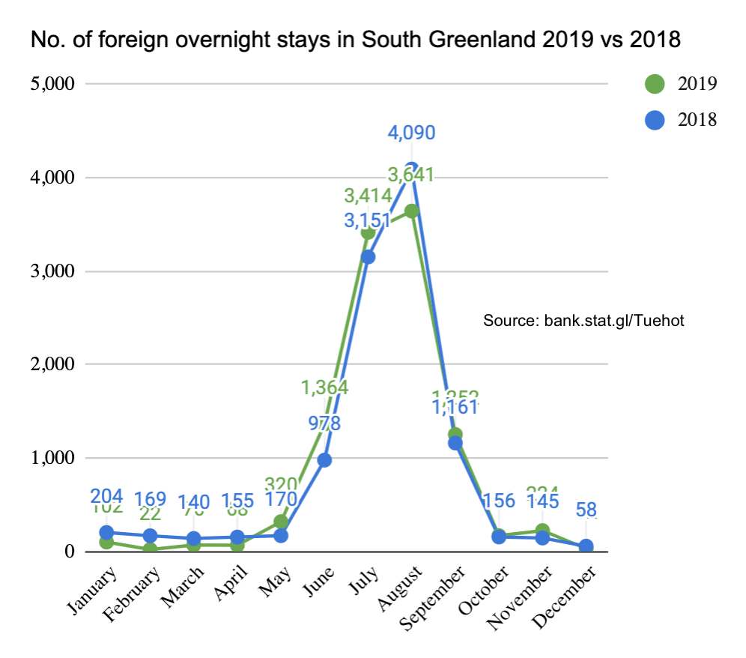
Seasonal Variation in South Greenland
The graph to the left shows the total occupancy rate in accommodations in South Greenland in 2019 vs. 2018. As one can see the spring and autumn season in 2019 had a better occupancy rate than in 2018, whereas the summer high season in 2018 had the highest occupancy rate, especially in the month of August. These data contain all types of guests – including GL citizens.
The graph on the right exclusively shows the number of international overnight stays (incl. DK) over the 12 months of the year, and here it is clear that there is very little tourism activity in the other months than the summer high season from June through September. This season pattern is characteristic of the region in the past many years. It seems to be a big challenge for the region to attract tourists outside of the summer high season, which makes it difficult for operators to live off tourism all year round.

Slide 7
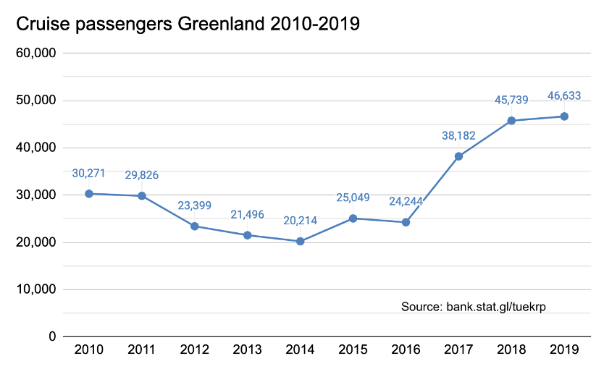
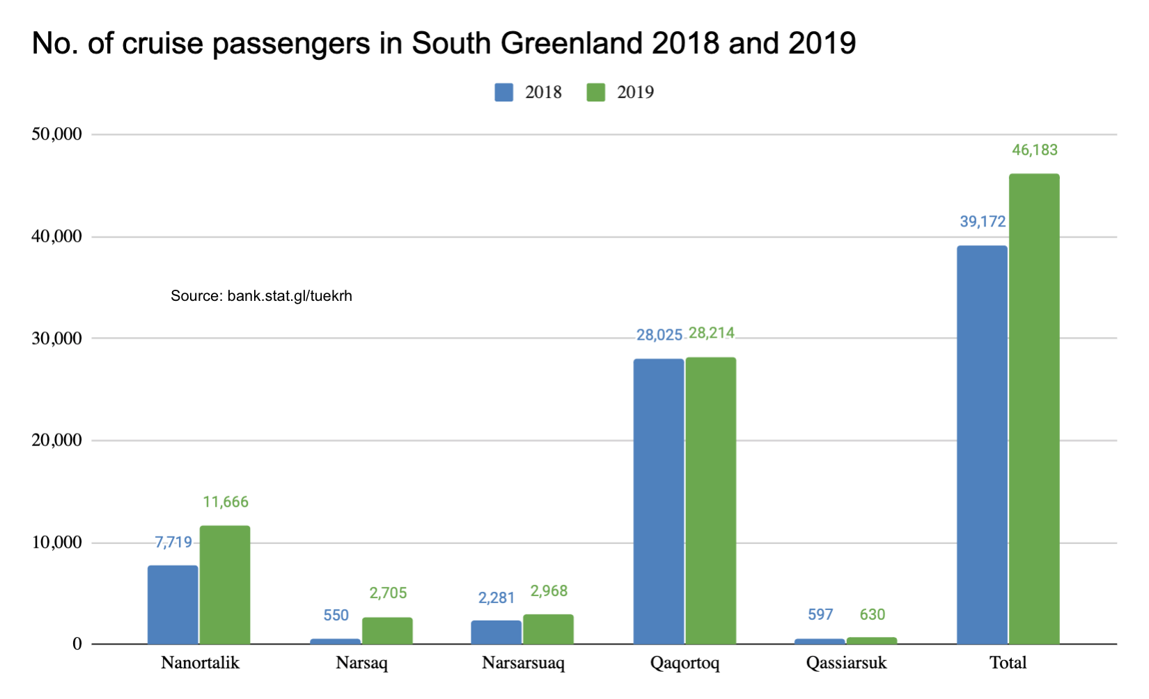
Cruise Tourism Nationally and in South Greenland
The graph on the left shows that the cruise tourism experienced a boom nationally in Greenland in 2017 and 2018 with a growth of 57.7 % and 19.8 %, respectively. In 2019 the growth was a more modest 2.0 %. But as the graph on the right shows the significant growth continued in South Greenland with a total growth in the passenger number of 17.9 %.
The primary reason for the growth in South Greenland was the 91 port calls in 2019 vs. 65 in 2018. The growth was primarily in Nanortalik and Narsaq.
Unfortunately, with the current Covid-19 crisis we can at present (primo May) note that there are a lot of cancelled port calls in 2020, so the trends observed in the past few years will be interrupted by a 2020 with a very negative development that may extend into 2021.

Slide 8
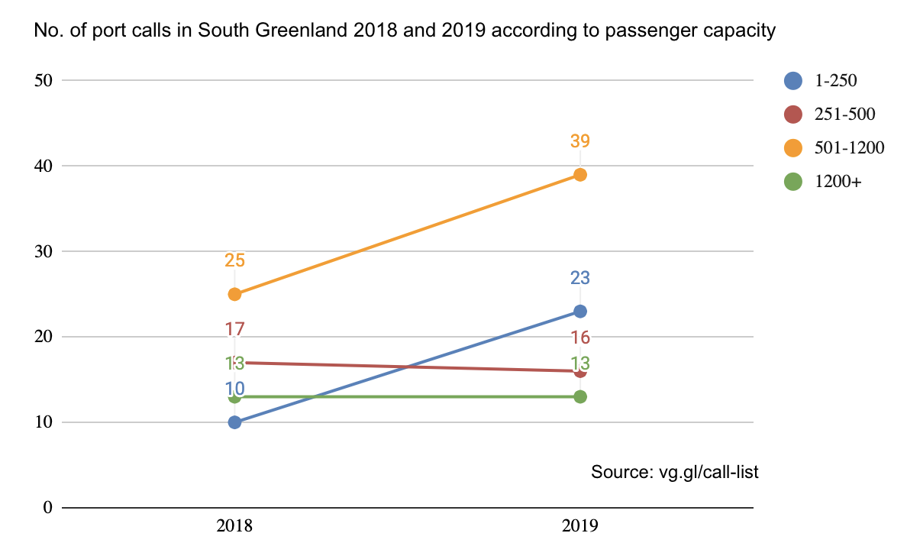
Cruise Tourism – Number of Port Calls According to Capacity 2017-2018
There was a large increase in the number of port calls in the pax classes 1-250 pax and 501-1200 pax, while the 1,200+ class remained at status quo. Only the 251-500 pax class have fewer (just one) port calls than in 2018.
Especially regarding the 1-250 pax class it is remarkable that there were more than double the amount of port calls as in 2018. which must be classified as an unusually positive growth. The growth in the 501-1200 pax class, however, represents an even larger number of passengers than the 1-250 pax class, as there could potentially be far more passengers onboard the ships in total.
Note: We do not have data on how many of the passengers came ashore on each port call. From a 2015 cruise survey we know that 98 % of the passengers came ashore at least once during their cruise in Greenland, which often consists of between 2 to 6 port calls.
The number of passengers on the ships on each port call is the best indicator of how many came ashore and purchased goods, services and tours.

Slide 9
Final Thoughts
The tourism development in South Greenland in 2019 had positive indicators in all tourism data, except for the number of unique guests (head count) in the accommodations. So overall, 2019 represented a positive tourism development, especially when it comes to cruises.
For the first time the region now has certainty that the regional 1,500 m airport in Qaqortoq will be realized with a scheduled opening in the autumn of 2023. That is exciting perspectives to look forward to and must be a cause for optimism in the long run, once the current health crisis is behind us.
All tourism data paints a picture of a region that is overwhelmingly a summer destination, and there is no doubt that South Greenland is fantastic during the summer. As the tourism strategy 2020-2023 of Visit Greenland and the Government of Greenland puts such emphasis on sustainability, including more full-time jobs in the industry, it is worth considering the opportunities to even out the tourism over the entire year, as this may present be some possibilities to take advantage of.
We wish you all the best possible 2020 season despite the Covid-19 crisis – and take care of each other out there!
Best regards
Visit Greenland
Compiled by Mads Lumholt, Visit Greenland, May 2020

