Slide 1
Tourism Statistics Report 2018
West Greenland

Slide 2
Introduction
The regional reports this year have been delayed because it did not make sense to publish them without cruise statistics on 2018 that was not made public until the 27th of August on stat.gl. Statistics Greenland was waiting for some long overdue port call registrations. It is highly recommended to read this short region specific report in addition to the national report as it deals with far more aspects of the tourism statistics and does so, on a much better statistical basis.
The region’s airport in Kangerlussuaq largely functions as a transit airport for passengers coming in or out of the country to or from completely different regions, so the passenger data on Kangerlussuaq does not describe the tourism development in West Greenland by itself – here the overnight stay data for the region are far more representative.
For many years Kangerlussuaq has, in the consciousness of the general population, mainly been perceived as a transit airport, while figures from West Greenland Business Council (https://sermitsiaq.ag/node/208439) shows that the tourism revenue in Kangerlussuaq in 2017 was approximately 100 million DKK, and the town is therefore one of Greenland’s biggest tourist destinations with 180 jobs in the tourism industry.
On the 18th of September 2019 the Minister of Defence Trine Bramsen signed an agreement with the Self-Government that the Danish Defense will keep Kangerlussuaq Airport open after the new airports in Nuuk and Ilulissat are ready around 2023. The future of the airport is thus an important step closer to clarification in relation to civilian traffic, as the Minister of Defence is positive about the possibility of continuing to allow civilian aircraft to continue to use Kangerlussuaq.
West Greenland Business Council has published the report ”Tourism development via Arctic Circle Road” which describes the possibility of the approximately 160 km long road between Kangerlussuaq and Sisimiut as follows: ”Arctic Circle Road will open a large rural area in Greenland and provide experiences along this road. Like in the rest of the world Arctic Circle Road will give access to areas and sights that are otherwise difficult to access. Roads have been crucial to the development of tourism around the world, and the ice cap road has made Kangerlussuaq into Greenland”.
The report notes that the road will be socio-economically viable for the community and will be earned in 11-14 years. It will be exciting to follow the plans of the region. It is clear that clarifying the future of Kangerlussuaq Airport is a prerequisite for these plans.
Below is a review of the available 2018 tourism data relevant to West Greenland.

Slide 3
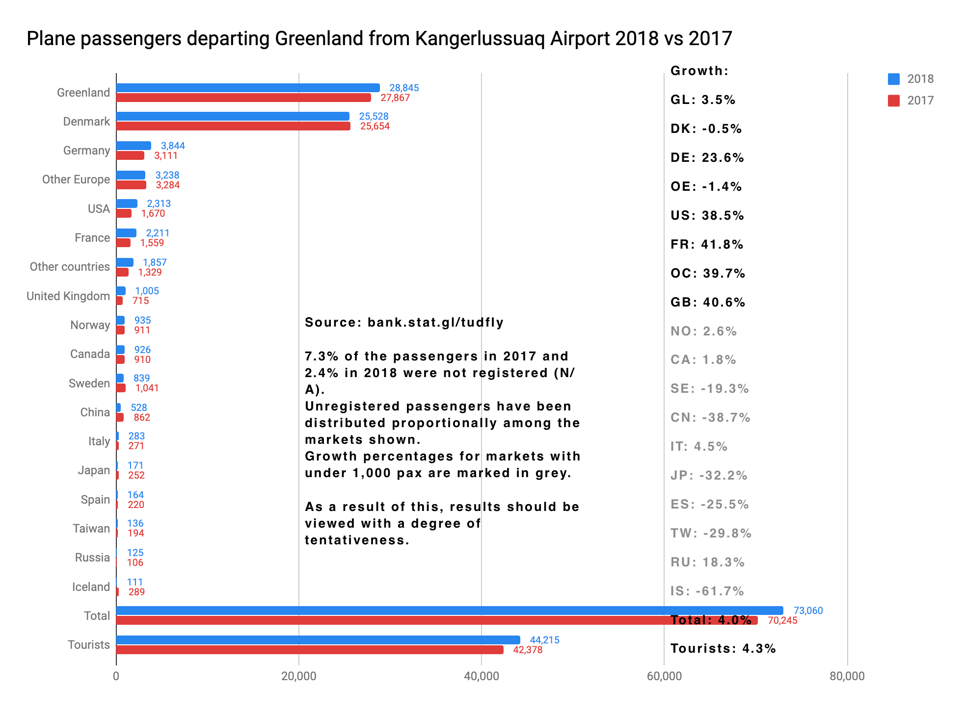
Flight Passengers Travelling Out of Greenland via Kangerlussuaq Airport
A 4.3 % growth in 2018 in international passengers travelling out of Kangerlussuaq can be considered satisfactory. However, the majority of the international passengers flying out of the country via Kangerlussuaq are transit passengers travelling from a different region than West Greenland, so it does not necessarily say a lot about the tourism development in West Greenland.
The tourist segments Germany, USA, France, Other Countries and Great Britain all represent a large growth of respectively 23.6 %, 38.5 %, 41.8 %, 39.7 % and 40.6 %.
It sound like a lot, men in terms of numbers it corresponds to respectively 733, 643, 652, 528 and 290 passengers, which can be many or few depending on what one compares it with.
Denmark and Other Europe segments experience status quo. The remaining segment each count less than 1.000 passengers, thus the growth rates are not statistically valid.
All in all, it is a positive picture. One must, however, take into consideration that 7.3 % of the passengers in 2017 and 2.4 % of the passengers in 2018 were not registered. The category “undisclosed” (i.e. the non-registered) have been distributed proportionally between the segments so as to make it easier to compare data on the two years.
Notes:
Flight Passengers Travelling Out of Greenland from Kangerlussuaq Airport 2018 vs 2017
Greenland, Denmark, Germany, Other Europe, USA, France, Other Countries, Great Britain, Norway, Canada, Sweden, China, Italy, Japan, Spain, Taiwan, Russia, Iceland, Total, Tourists
Source: bank.stat.gl/tudfly
The category ”Unknown” is distributed proportionally between the featured markets.
Thus 7.3% of the passengers in 2017 and 2.4% in 2018 were not registered.
Growth rates in markets with less than 1.000 pax are marked in grey.
Due to the above factors these data must be taken with reservations.
(kolonne til højre)
Growth
GL: 3.5%
DK: -0.5%
DE: 23.6%
OE: -1.4%
US: 38.5%
FR: 41.8%
OC: 39.7%
GB: 40.6%
NO: 2.6%
CA: 1.8%
SE: - 19.3%
CN: -38.7%
IT: 4.5%
JP: -32.2%
Es: -25.5%
TW: -29.8%
RU: 18.3%
IS: -61.7%
Total: 4.0%
Tourists: 4.3%

Slide 4
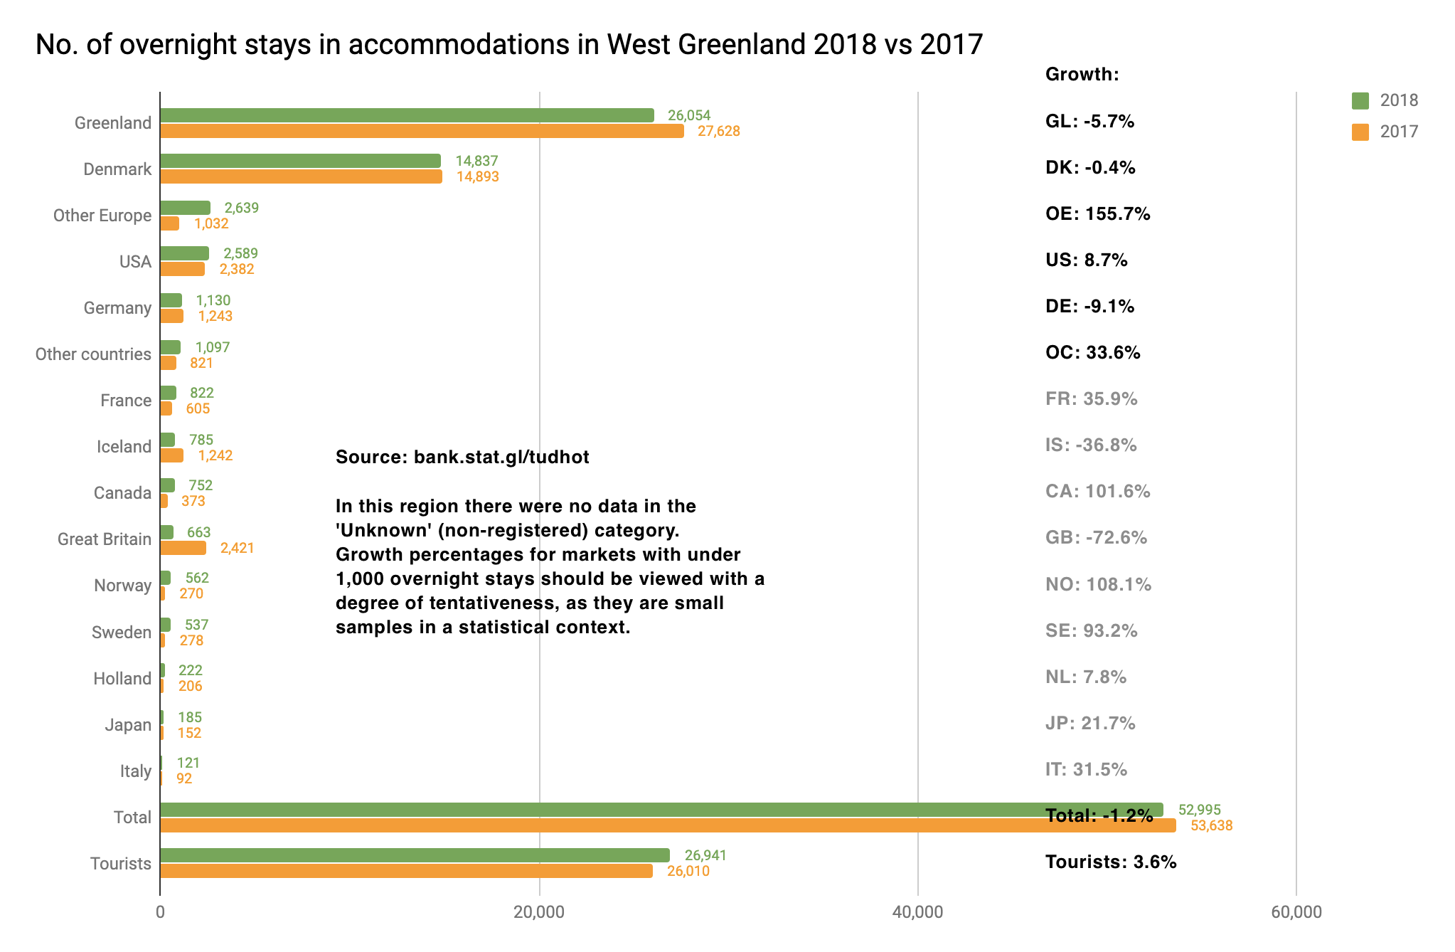
Number of Overnight Stays in the Region
The registration submissions cover 84.3 % of the bed capacity in West Greenland. The remaining 15.7 % bed capacity, counted in the number of beds, are CVR registered accommodations that do not submit registrations. The reader must note that an unknown share of the tourists spend the night under open sky, in private homes or in accommodations that do not submit registrations, so the data below must be viewed accordingly.
A growth of 3.6 % appears to be a positive indication for the region and a better source of information than the flight passenger statistics from Kangerlussuaq Airport (previous page), as the majority of the passengers, as mentioned, are passing through from another region.
The segment Denmark is at status quo. He segment Other Europe shows a growth of 155.7 % which in this segment is the equivalent of 1,607 more overnight stays than in 2017.
The US segment shows an increase of 8.7 % which represents 207 more overnight stays.
The Germany segment shows a decline of -9.1 % the equivalent of 113 overnight stays.
The Other Countries segment shows a growth of 33.6 % representing 276 overnight stays.
The rest of the segments represent less than 1.000 overnight stays, thus the growth rates are not statistically valid.
Notes:
Number of Overnight Stays in West Greenland 2018 vs 2017
Source: bank.stat.gl/tudhot
There were no one in the category ”Unknown” (non-registered) in this region in 2017 and 2018.
The growth rate in markets with less than 1.000 overnight stays are to be taken with reservations and they are therefore marked in grey.
Greenland, Denmark, Other Europe, USA, Germany, Other Countries, France, Iceland, Canada, Great Britain, Norway, Sweden, Holland, Japan, Italy,
Total
Tourists
(kolonne til højre)
Growth:
GL: -5.7%
DK: - 0.4%
OE: 155.7%
US: 8,7%
DE: -9.1%
OC: 33.6%
FR: 35.9%
IS: -36-8%
CA: 108.1%
SE: 93.2%
NL: 7.8%
JP: 21.7%
IT: 31.5%
Total: -1.2%
Tourists: 3.6%

Slide 5
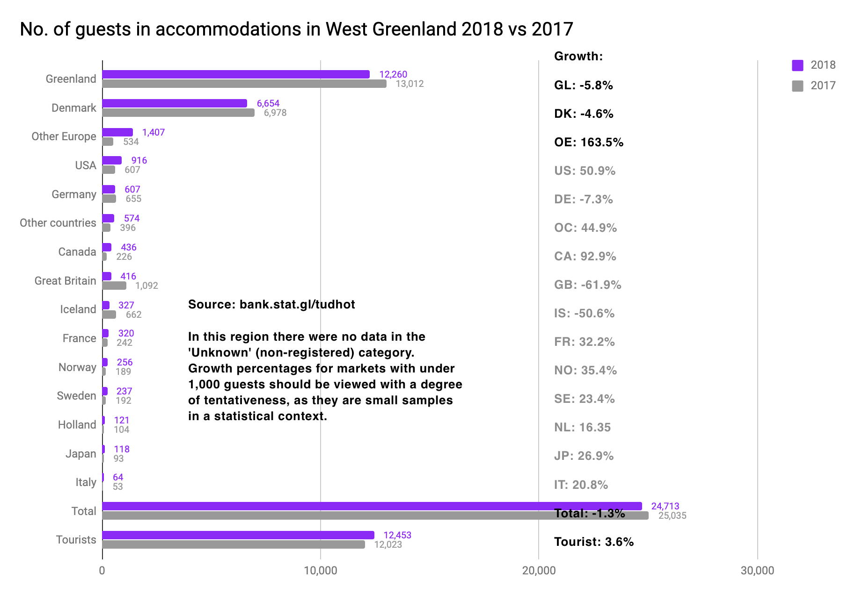
Number of Individual Guests in the Region
With 3.6 % growth in the number of individual international guests in the accommodations in region West Greenland it is completely on the same level as the growth in the number of international overnight stays, which usually is what is to be expected. The two growth figures do not necessarily follow each other, as it among other things may vary from year to year how many overnight stays the tourists have bought on average in accommodations in the region.
Where the number of overnight stays was at status quo for the DK segment, there is a decline of 4.6 %, the equivalent of 324 guests.
The growth in Other Europe is a staggering 163.5 % representing a total of 873 guests.
A very nice growth of 50.9 % in the US segment as well, representing 309 guests.
The remaining segments are represented by relatively small samples and thus the growth figures may seem disproportionately big.
There is, however, reason to highlight the growth for the Canada segment of 92.9 %, as it represents a total of 210 more guests than in 2017.
The data must be viewed with the reservation as guests that have stayed in other places than in accommodations that submit registrations are not shown here.
Notes:
Number of Guests in Accommodations in West Greenland 2018 vs 2017
Greenland, Denmark, Other Europe, USA, Germany, Other Countries, Canada, Great Britain, Iceland, France, Norway, Sweden, Holland, Japan, Italy, Total, Tourists
Source: bank.stat.gl/tudhot
Der were on one in the category ”unknown” (non-registered) in this region in 2017 and 2018-
Growth rates in markets with less than 1.000 pax are marked in grey, as they statistically speaking are small samples and thus must be taken with reservations.
(kolonne til højre):
Ret ØE til OE
og ret
ØL til OC
Dernæst skal der være punktummer i stedet for kommaer i alle tallene i kolonnen.
Total: - 1-3%
Tourists: 3.6%

Slide 6
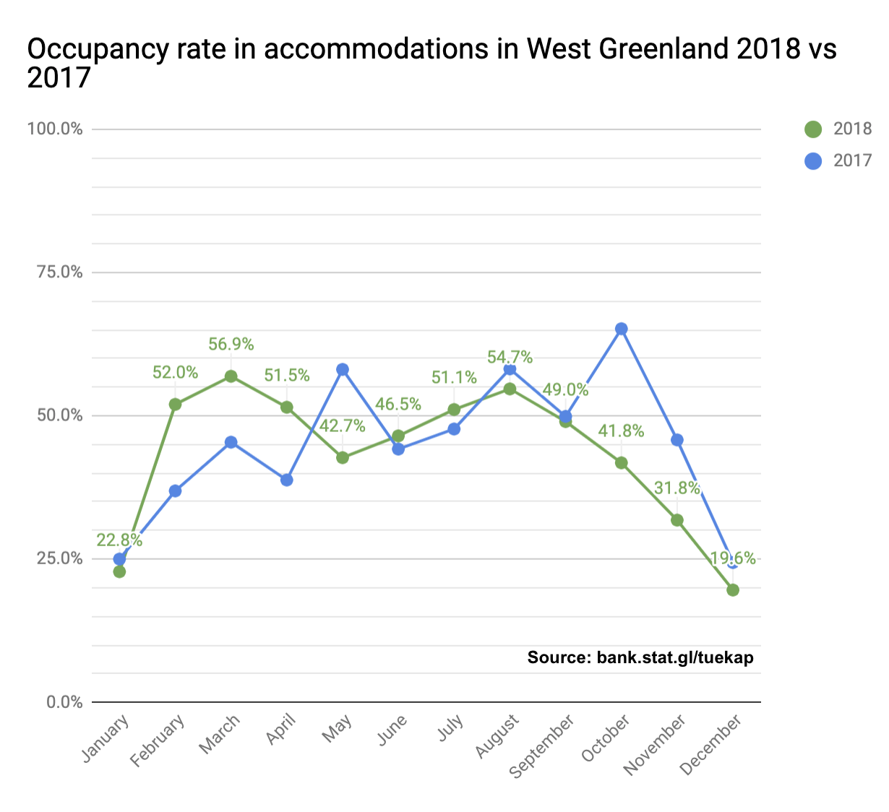
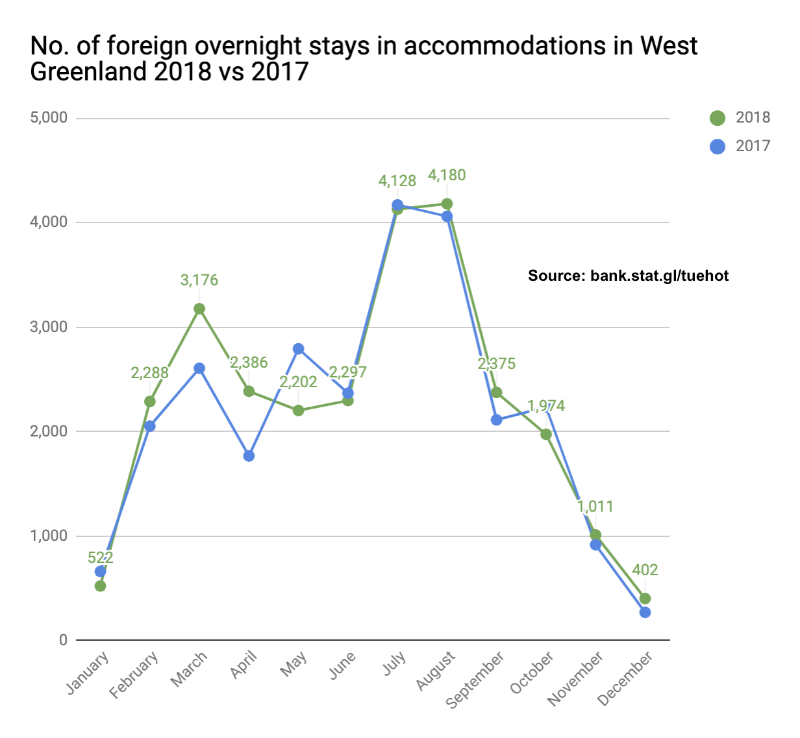
Occupancy Rates in Accommodations in the Region
The average occupancy rate in the accommodations in West Greenland was 43.4 % in 2018 versus 45.0% in 2017. As the graph on the left clearly shows the spring season was better in 2018 than in 2017 which in turn saw a better autumn season. Overall the season trend for West Greenland is more even throughout the year than what is experienced in the other regions. This provides better conditions for year-round employment in the tourism industry. Even in the summer high season there is plenty of available capacity that offers good conditions for receiving quite a few more tourists without having to invest in expanding the overnight stay capacity.
Here the graph to the left shows the occupancy rate for both Greenlandic and international guests the graph on the right only shows the number of international overnight stays over the 12 months of the year where a certain season trend can be observed in July and August. It is, however, not a significantly “steep” summer high season as is the case in the regions of Avannaata-Qeqertalik, Kujalleq, and Sermersooq East.
Notes:
Graf til venstre:
Occupancy Rate in West Greenland 2018 vs 2017
Source: bank.stat.gl/tudkap
Graf til højre:
International Overnight Stays in West Greenland 2018 vs 2017 According to Month
Source: bank.stat.gl/tudhot
Fælles for begge grafer:
January, February, March, April, May, June, July, August, September, October, November, December

Slide 7
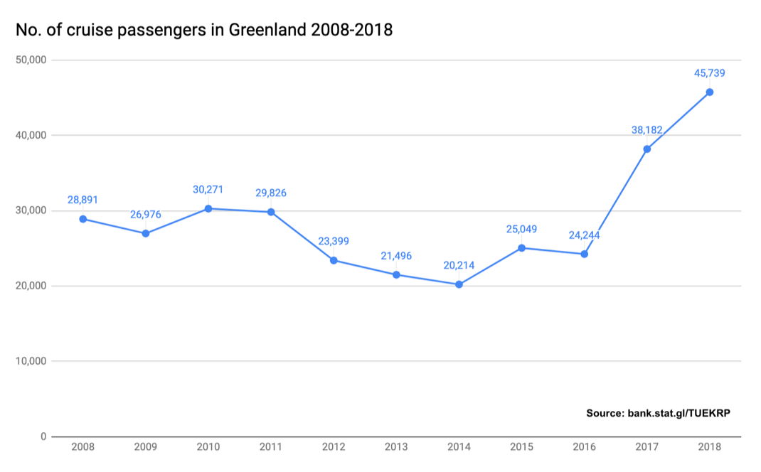
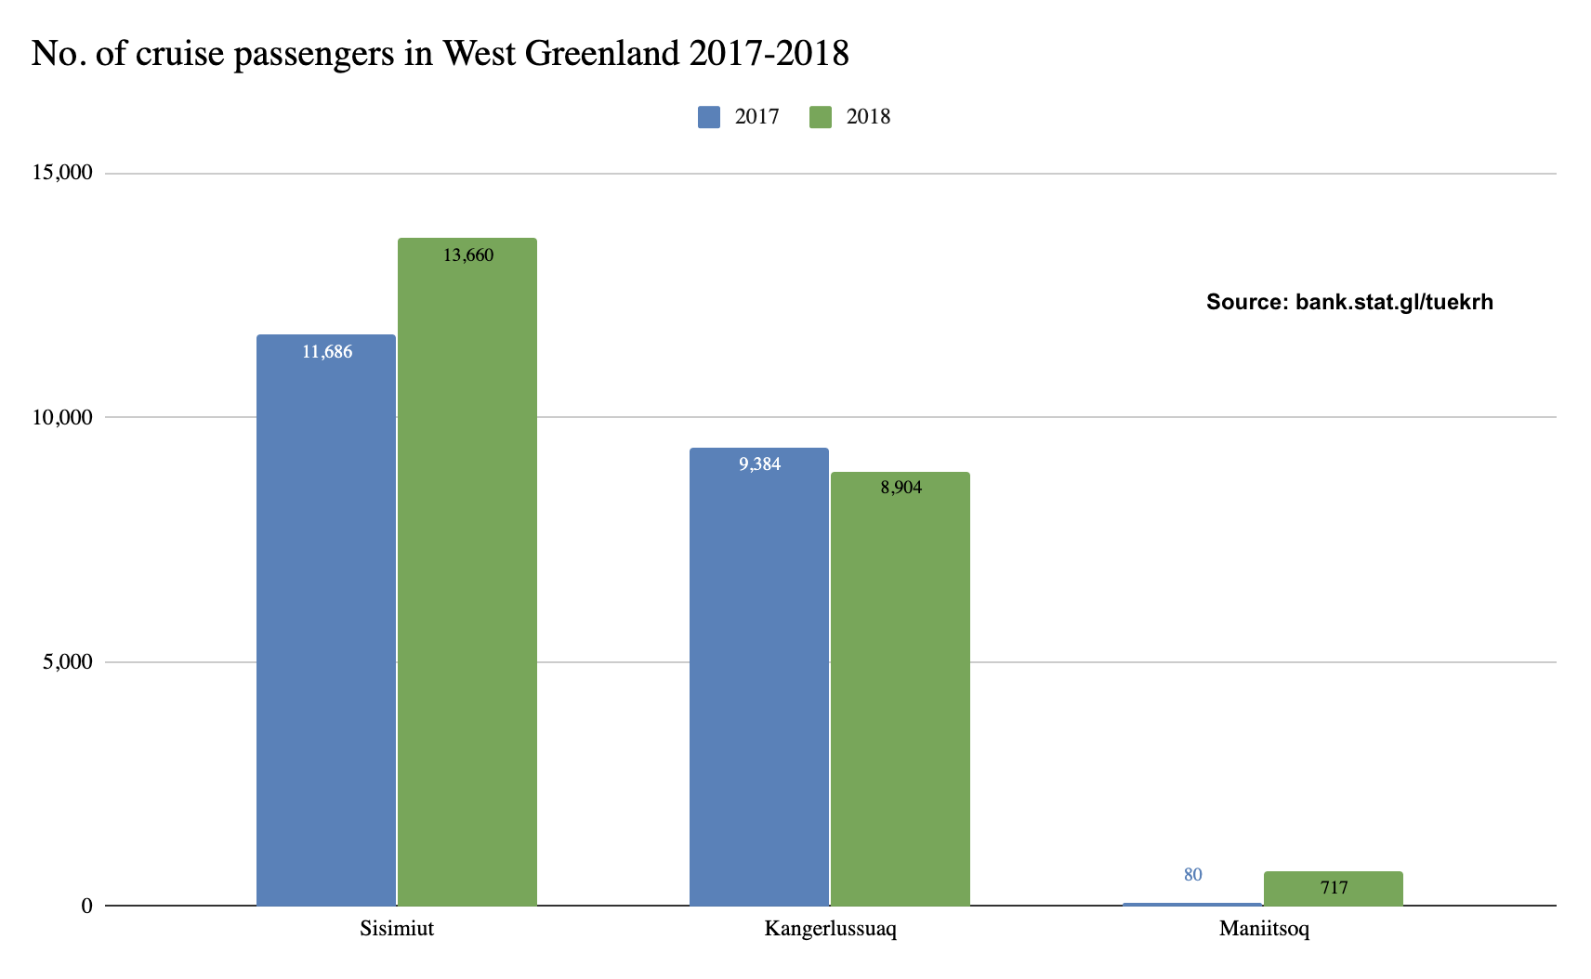
Cruise Tourism – Number of Guests 2008-2018
On the 27th of august 2019 Statistics Greenland published the cruise statistics on 2018. It had been delayed due to some late port call registration submissions. On the same date the revised numbers on 2017 were published on bank.stat.gl/tudkrp. The latest numbers (please, see the graph to the left) shows a significant increase in the number of passengers in 2017 and 2018, the equivalent of a growth of 57.5 % from 2016 to 2017 and a 19.8% growth from 2017 to 2018 nationally. The numbers for 2015 and 2016 are currently being revised and are expected to be adjusted upwards.
In the graph on the right is the number of passengers in West Greenland in 2017 and 2018. There was a combined growth of 10.1 % from 2017 to 2018 in the number of passengers. Sisimiut saw a growth of 16.9 % and Kangerlussuaq -5.1%. Maniitsoq only had one port call in 2017 by a Spitsbergen with a passenger capacity of 335 passengers but according to the port call registration it only carried 80 passengers. In 2018 there were 5 port calls, including by a Fram (1 port call of a maximum of 280 pax) and Seaborn Quest (1 port call of a maximum of 450 pax).
Notes:
Graf til venstre:
Number of Cruise Passengers in Greenland 2008-2018
Source: bank.stat.gl/tudkrp
Graf til højre:
Number of Cruise Passengers 2017 and 2018 in West Greenland

Slide 8
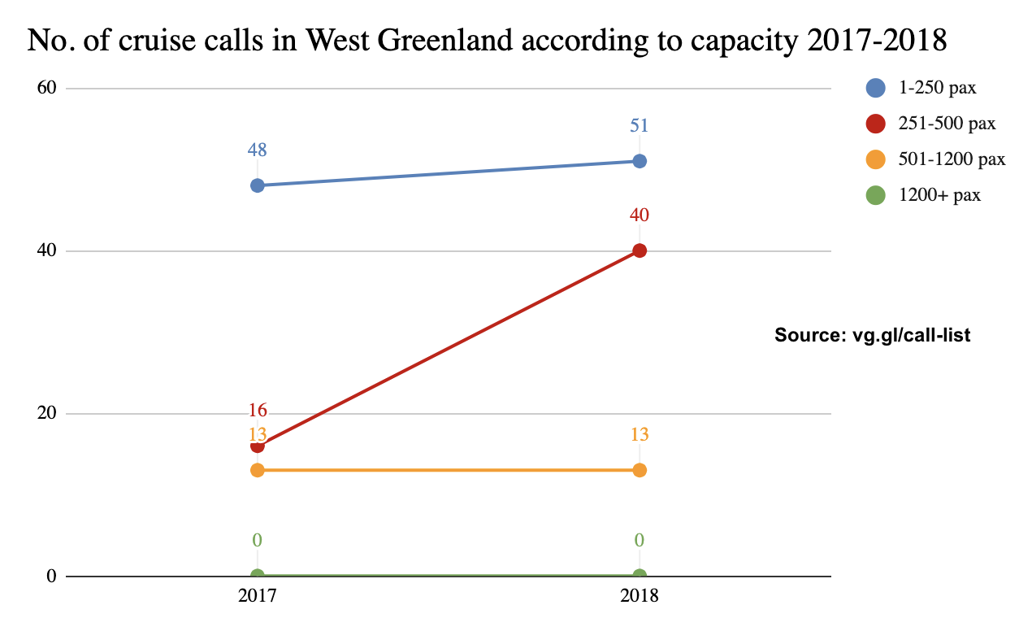
Cruise Tourism – Number of Port Calls According to Capacity 2017-2018
In the graph below one can see the number of port calls in West Greenland in 2017 and 2018 according to 4 so called “pax classes” – i.e. according to the passenger capacity of the ships. From 2017 to 2018 there has been a significant growth in the 251-500 pax class from 16 port calls in 2017 to 40 port calls in 2018, while there has been a small increase in port calls for the smallest pax class. The remaining pax classes have experienced status quo.
It is unclear if the significant growth in the number of port calls for ships in the 251-500 pax class in the region is indicative of a trend in the market. Based on experience there are some fluctuations from year to year compared to which ships are used for cruises in Greenland and which regions of Greenland are navigated in the current timetables. The development in one region may be positive, whereas it is negative in another, only for the tables to turn the following year.
2017 saw a total of 77 port calls in West Greenland. In 2018 the total was 104 port calls. So far 93 port calls have been announced in 2019, but this number may change a little before the end of the year.
Notes:
Number of Port Calls in West Greenland According to Passenger Capacity 2017 and 2018
Source:
vg.gl/call-list

Slide 9
Final Thoughts
As previously described flight passenger statistics from Kangerlussuaq Airport cannot be used to uncover the tourism development in West Greenland, however, the overnight stay statistics can. It shows a growth of 3.6 %, which is not high compared to the global average of approximately 6 %, but it can still be considered satisfactory.
A growth of 10.1 % for cruise tourism in the region is positive for the players who succeeded in benefiting financially from that growth. In 2015 Visit Greenland carried out a cruise survey with the company GP Wild, which showed that each passenger on average spends approximately 50 € on each port call (approximately 25 € on trips and 25 € on “other merchandise and services”). On average each guest visits 3-4 towns during a cruise, so there seems to be potential to create additional revenue in relation to port calls. In the summer of 2020 Visit Greenland will once again carry out the cruise survey in order to monitor the development in spending patterns. At the request of destination companies or private operators Visit Greenland hosts free “Port Readiness” courses that focus on how to, on the hand, to improve the experience for the passengers and on the other hand increase revenue for the local operators.
In the future strategy for the period 2020-2023 Visit Greenland will focus even more on sustainability in the tourism industry in Greenland. One of the prerequisites of a sustainable development is to bet on adventure tourism rather than mass tourism. A sustainable and responsible development of the adventure tourism includes attracting tourist that will stay longer, visit more cities on the same trip and buy more merchandise, services and tours locally all the while acting responsibly toward humans and nature. It has to do with a better utilization of the shoulder and low season and a better geographical distribution of the tourism. What characterizes mass tourism elsewhere in the world is that it concentrates on the major destinations leaving most of the revenue in the hands of large international chains in the tourism industry.
In its tourism strategy West Greenland Business Council (see the Introduction) puts emphasis on locally rooted economically sustainable adventure tourism that is spread out over the year, which corresponds well with the sustainability focus of the municipality. There are already large attractions in the region such as the new UNESCO World Heritage site, the ice sheet as well as the popular Arctic Circle Trail, and exciting projects such as the Arctic Circle Road are on the drawing board, but they are dependent on Kangerlussuaq Airport to remain as an influx option for international tourists. It is our hope that West Greenland will soon get clarification and we wish everyone a really productive and good 2019 tourist season!
Best regards
Visit Greenland
Compiled by Mads Lumholt, Visit Greenland, September 2019

