Slide 1
Tourism Statistics
Report 2017
West Greenland

Slide 2
Introduction
As explained in the national tourism statistics report 2017 the flight passenger data from 2017 unfortunately cannot be used to identify trends in the Greenlandic tourism development as it is not complete. Visit Greenland, Statistics Greenland and Mittarfeqarfiit have joined forces to ensure a more complete registration in 2018.
Thus this regional report primarily focuses on the overnight stay statistics and the cruise statistics. We recommend that this report is seen as a supplement to the national report as that is based on a larger data volume minimizing the statistical uncertainty. Furthermore the national report looks in depth at the latest tourism interviews conducted by two Visit Greenland interns from the tourism program at Aalborg University during July and August 2017.
Overall it is difficult to decide whether or not the tourism development in West Greenland has been more positive than negative over the course of 2017. There are indications of both depending on the different data sets.
The tourist overnight stay statistics, the cruise statistics as well as feedback from Greenlandic tourism operators show that overall 2017 was a good year for tourism in Greenland. As the incomplete flight passenger data from this year could not be used we chose instead to ask 240 Greenlandic tourism operators about their 2017 season and their expectations for 2018. We received from a total of 82.
The numbers on overnight stays show an overall growth of approximately 10% while the number of cruise passengers has increased by 13.1%. Only 5.5% of the tourism operators reported negative growth while the rest either had a season similar to 2016 or experienced growth.
Globally 2017 has been one of the best years in recent times with a total growth of 7% with Europe as a region experienced a growth of 8%. The prognosis on the coming years points to a continued medium-high global growth of approximately 5%.
Iceland is still a part of the growth elite and in 2017 the country experienced a growth in the number of international passengers of 24.2%. It is expected that during 2018 more than 10 million passengers will pass through Keflavik. Despite the fact that Air Iceland Connect report a negative growth of -9.7% on routes between Iceland and Greenland from 2016 to 2017 the potential for Iceland-Greenland combination trips is still relevant to consider also by virtue of the feedback from many of the 292 land based tourists interviewed by Visit Greenland in July-August (please, see the national tourism report p. 28).
Each region undeniably still has its challenges whether it’d be accessibility, over- or under-capacity in the high season, logistics and the like. However since 2014 there has been a relatively nice growth nationally and overall there is reason for continued optimism when it comes to the next few years.

Slide 3
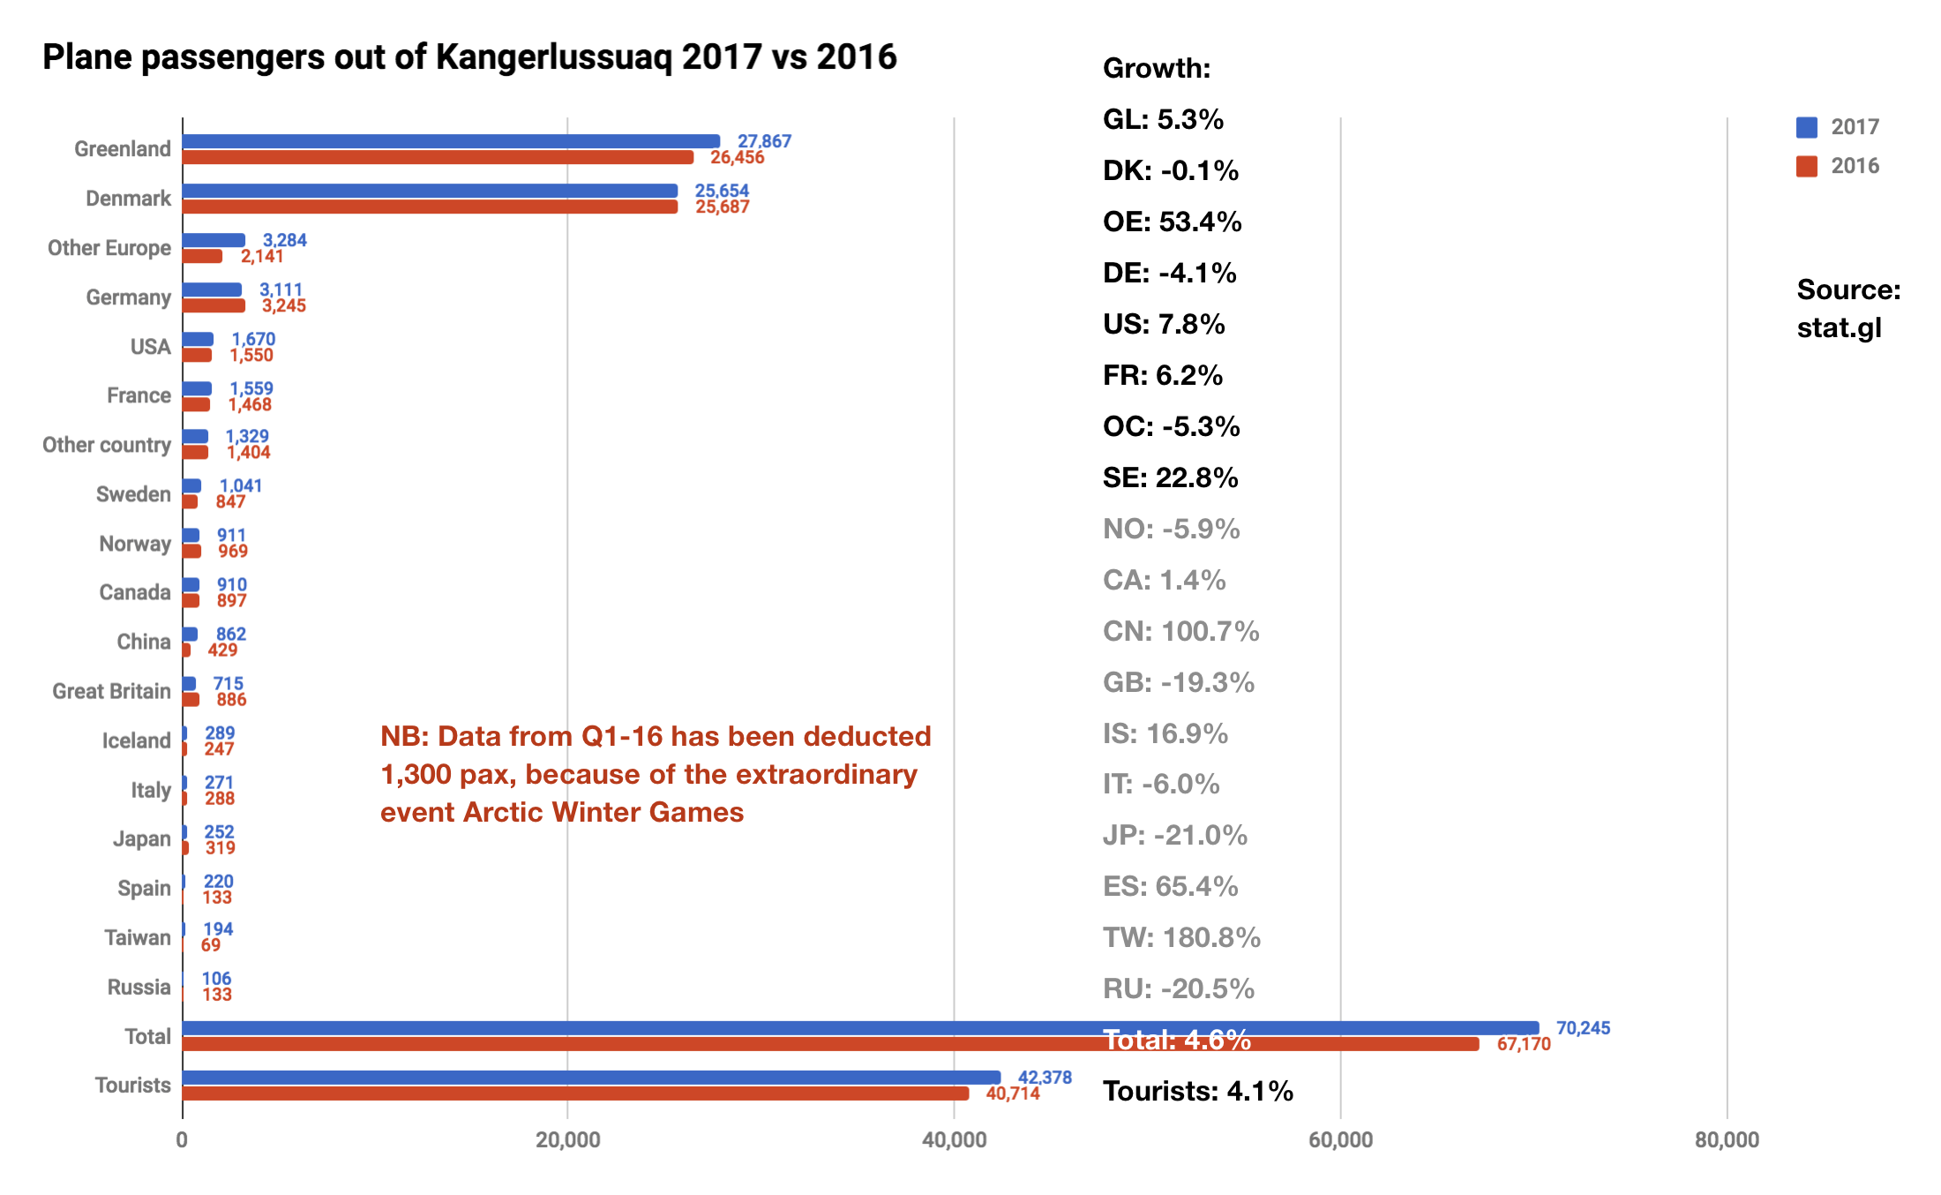
Flight Passengers Travelling Out of Greenland via Kangerlussuaq Airport
As mentioned in the introduction the registration of the country of residence of the passengers in 2017 is incomplete. With only 7.3% non-registered Kangerlussuaq Airport has not been as affected as other airports. In other airports, however, the number of missing registrations has been so large that VG and Statistics Greenland do not consider the total data valid.
Growth rates for country segments with less than 1,000 passengers are listed in grey as a difference of even as few as a couple of individuals from year to year can cause exaggerated fluctuations in the growth rate (whether it’d be positive or negative growth).
There is not direct correlation between the number of flight passengers travelling out of Kangerlussuaq Airport and the number of tourists visiting the West Greenland region as most of them are in transit from their last destination and back out of the country.
Because of this and the incomplete registrations the flight passenger statistics on Kangerlussuaq cannot be used to identify trends in the tourism development in West Greenland.

Slide 4
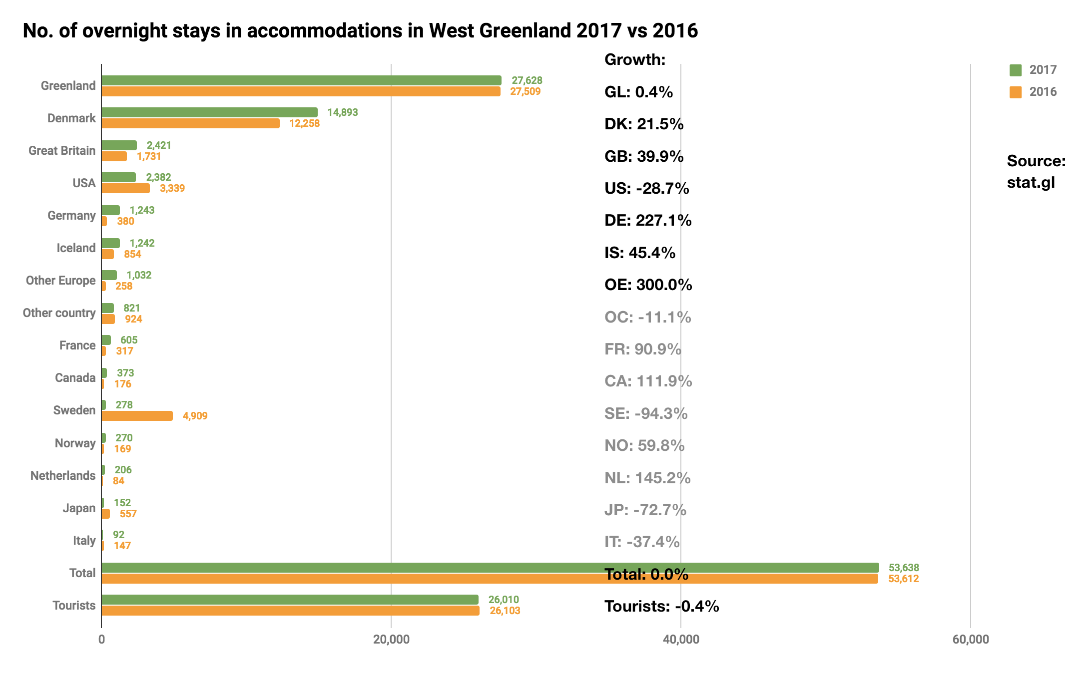
Number of Overnight Stays in the Region
The number of tourist overnight stays in the region is status quo with a growth of -0.4%. Growth rates for all country segments with less than 1,000 overnight stays are listed in grey to indicate that reservations must be taken as a difference of only a few overnight stays from year to year can cause disproportionate percentage fluctuations.
A 21.5% growth in the largest segment, Danish citizens, is very positive. The same goes for citizens of Great Britain with a growth of 39.9%.
Citizens of the USA is the segment with the largest decline in the number of tourist overnight stays, in all 957 persons, the equivalent of a negative growth of -28.7%.
With a growth of 227.1% the segment Germany looks like a very positive standout, but the difference from the year before is so great that either registration errors have made their way into the data or the ‘natural’ fluctuations from year to year are simply rather drastic.
The same is true for the segment Other Europe with a growth of a staggering 300%.
The following page concentrates on the number of individual guests in the region and the data here offer a rather big surprise.

Slide 5
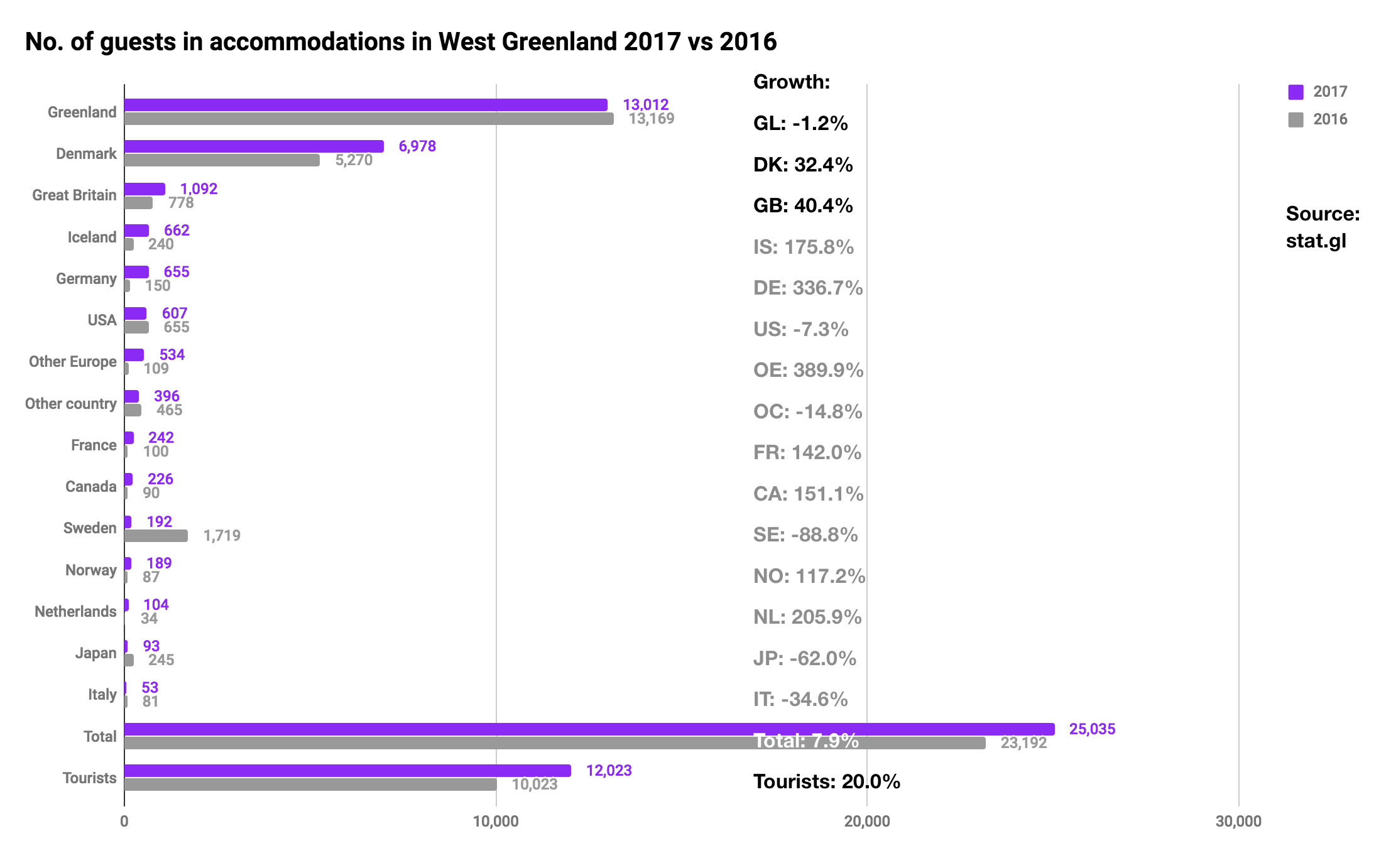
Number of Individual Guests in the Region
The 20% growth in the number of individual tourist in the accommodations in the region is in stark contrast to the numbers on the previous page where the percentage growth in the number of individual tourist overnight stays is -0.4%. If these data is a 100% correct the consequence is that there have been 20% more tourists in the accommodations but with the same number of overnight stays sold to tourists as the year before. If one was to cross check with the numbers on the average number of overnight stays bought per guest, one will find that to be 2.62 for international guests (tourists) in 2016 and 2.02 in 2017.
That is a drastic fall in the average number of bought overnight stays per international guest.
A possible explanation is that there has been a far greater tendency for the tourists in 2017 to stay a shorter period of time in West Greenland and then fly or sail to a different region in Greenland or directly out of the country again.
If that is the case on the positive side we can conclude that more tourists have bought a stay in the accommodations in the region as opposed to private accommodation or camping outdoors.
On a less positive note it is likely that the turnover for the accommodations that submit registrations is no higher than in 2016 as it is the number of individual overnight stays sold and not the number of individual guests that affects the turnover the most.

Slide 6
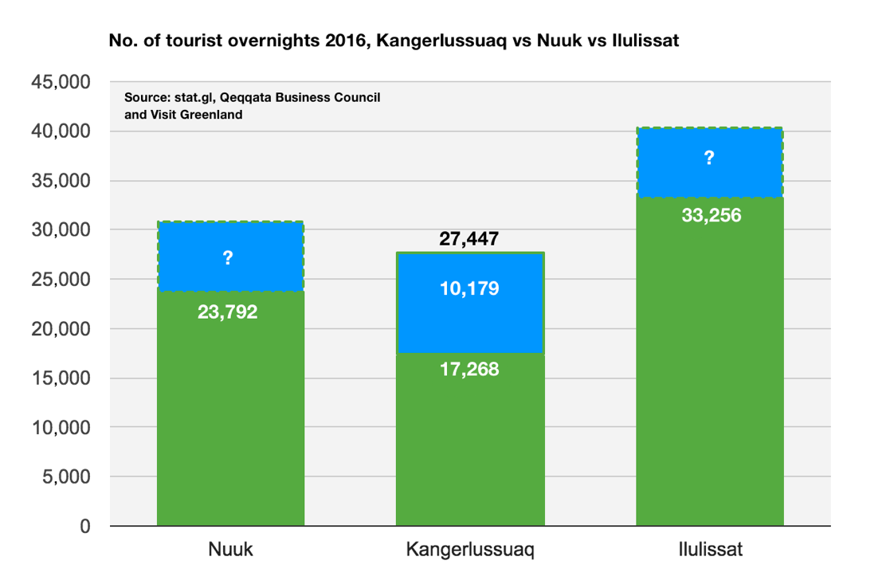
Number of Tourist Overnight Stays Not Registered in 2016
In the regional tourism statistics report from last year dealt with the question of the number of tourist overnight stays from accommodations in Kangerlussuaq besides those that submit registrations to Statistics Greenland. In 2017 Visit Greenland cooporated with the West Greenland Business Council in order to gather complete sets of data on the number of tourist overnight stays in Kangerlussuaq for 2016, and succeeded in doing so. As it turns out the 17,268 tourist overnight stays that figure in the database on stat.gl only comprise 63% of the real number of 27,447. Thus an additional 10,179 tourist overnight stays were not registered and submitted in 2016.
Something similar is most likely the case other places in Greenland, but compared with the volume and capacity at the accommodations in Kangerlussuaq that do not submit registrations the problem in this region is somewhat greater here than at the other destinations.
At this time there have not been enough resources to seek out the same data. One can hope that the accommodations in question in the region will see how valuable their data is in the big picture. VG and Statistics Greenland are continually working to include more and more accommodations in the registration all over Greenland.

Slide 7
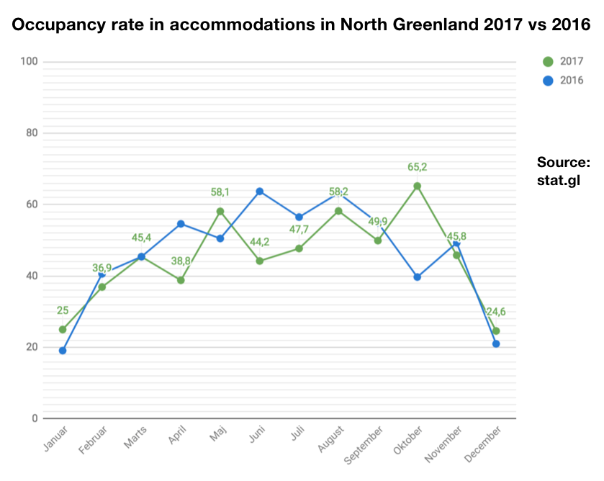
Occupancy Rate in Accommodations in the Region
The average occupancy rate in 2017 was 45.0% and 46.5% in 2016. This differs slightly from our expectations since 2017 saw 20% more international guests. It is however impossible to discern the tourists from the Greenlandic citizens in the data on occupancy rate as this is featured as a total sum.
Overall with a maximum occupancy rate of 65.2% in bed capacity there is room for both a season expansion and a larger contingent of tourist in the high season. This way at least on paper there is no bottle neck in the high season as is the case in Ilulissat. The capacity limitations as far as airline seats in the high season are concerned at this time is an entirely different matter.
The occupancy rate is decided as the number of room rented compared with how many rooms the hotel has, thus this does not say anything about how many guests have stayed in the rooms in question. That is typically one or two guests per room rented.
Business travellers are usually one guest per room whereas tourists most often rent a room along with a travel mate.
For the accommodations the number of rooms rented is obviously a more important parameter for the turnover than the number of individual guests.

Slide 8
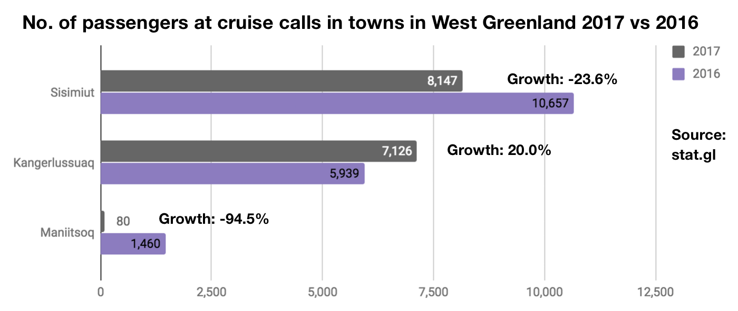
Number of Cruise Passengers in the Region 2017 vs 2016
Overall Greenland had 13.1% more cruise passengers in 2017 vs 2016, but the West Greenland region experienced a negative growth of -15.0%. That obviously is not positive but we do however know from comparisons with previous years as well as a number of years that there are large fluctuations in the number of passengers on ships in the different regions from year to year.
Especially Sisimiut has seen a decline in the total number of passengers to visit the city from 2016 to 2017 which can be attributed mainly to the fact that Aida Aura, with a capacity of 1,266 pax visited the city in 2016, but not in 2017. Maniitsoq also had only 80 cruise guests in 2017 vs 1,460 in 2016 which is due to a more general decline in the number of port calls.
Fortunately Kangerlussuaq experienced a growth of 20% the equivalent of 1,187 more cruise passengers that visited the village in 2017 compared to 2016.

Slide 9
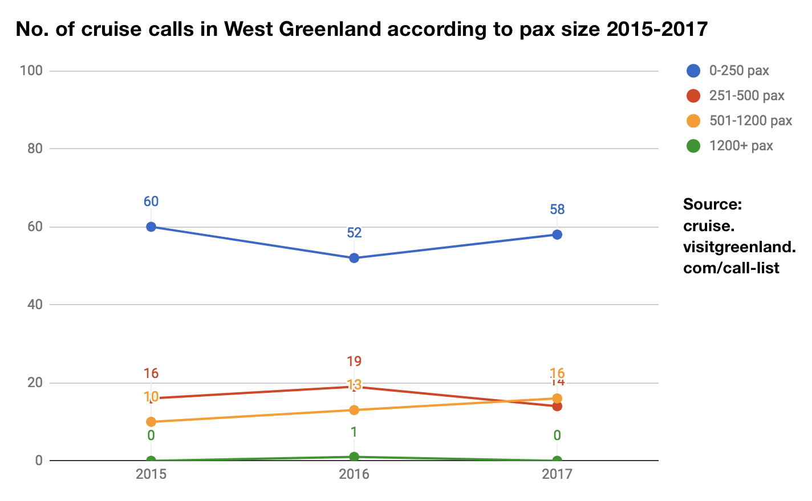
Number of Cruises in Greenland According to Passenger Capacity 2008-2017
Despite a decline in the total number of passengers on ships with port calls in cities in the region in the course of 2017, the picture is more positive when it comes to the number of port calls according to pax category. The pax categories are traditionally divided into 4 pax (passenger) categories 0-250, 251-500, 501-1200 and 1200+.
Though some fluctuations can be found, the number of port calls is virtually the same from year to year when the four pax categories are combined.
As mentioned on the previous page we are used to fluctuations from year to year that might look a bit drastic, but at the same time this is the norm in the cruise business rather than something to base major conclusions on.
The cruise lines are good at retaining most of the turnover in terms of product offerings for their passengers, but there is still an untapped potential for additional sales when the guest are ashore. Be it tour products, cultural offers and events or sale of arts and crafts and souvenirs.
Some tourists may have DKK, but if not, one might consider getting a payment solution that accepts international credit- and debit cards such as Visa, Mastercard, American Express, Diners etc.
One can rent a small mobile credit card terminal from nets.dk for circa 350 DKK/month and a fixed transaction fee of approximately 115 DKK/month for international credit- and debit cards. For more information, please write lumholt@visitgreenland.com.

Slide 10
Final Thoughts
Overall it is difficult to determine if the tourism development in West Greenland has been more positive than negative in the course of 2017. There are indications of both depending on the different sets of data.
With some certainty we can determine that the national tourism development is growing by approximately 10% and this point to a healthy demand for Greenlandic tourism experiences from the international market in which we always include tourists residing in Denmark. That tends to have a positive trickle-down effect on the regional level, but of course this has to be supported by initiatives, marketing as well as other actions to boost the visibility of the region. The West Greenland Municipality’s great focus on tourism sends a very positive signal both internally and externally. It will be exciting to follow the plans for either an ATV-track or a nature trail between Kangerlussuaq and Sisimiut, and it is clear that the realization of either will further increase the tourism potential.
At the same time the application for the Aasivissuit/Nipisat area to be appointed as UNESCOs World Heritage is expected to be decided in the course of 2018 – a decisive factor for the region as it represents a huge potential for the area to raise its profile internationally. UNESCO points to how important ’managing tourism infrastructure’ is. The UNESCO application and the plans for an improved traffic and tourism infrastructure can be crucial for the future tourism development of the region.
Finally we wish you all a successful 2018 tourism season and we look forward to a mutually beneficial cooperation.
Best regards
Visit Greenland
Compiled by Market Analysis Consultant Mads Lumholt, April 2018

